Slide 1
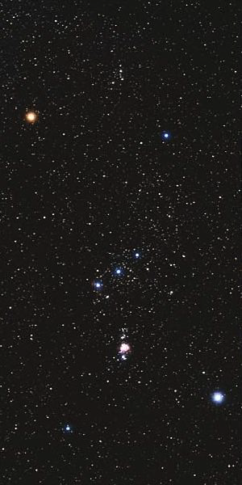
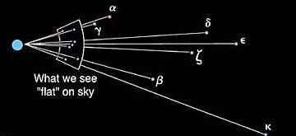
Constellations and designations of stars
Constellation = random collection
of stars (figure)
α
γ
Stars’ names:
Greek letter + constellation name
Orionis (= Betelgeuse)
γ Orionis (⇒ No special name)
α Canis Majoris (= Sirius)
ζ
β
κ

Slide 2
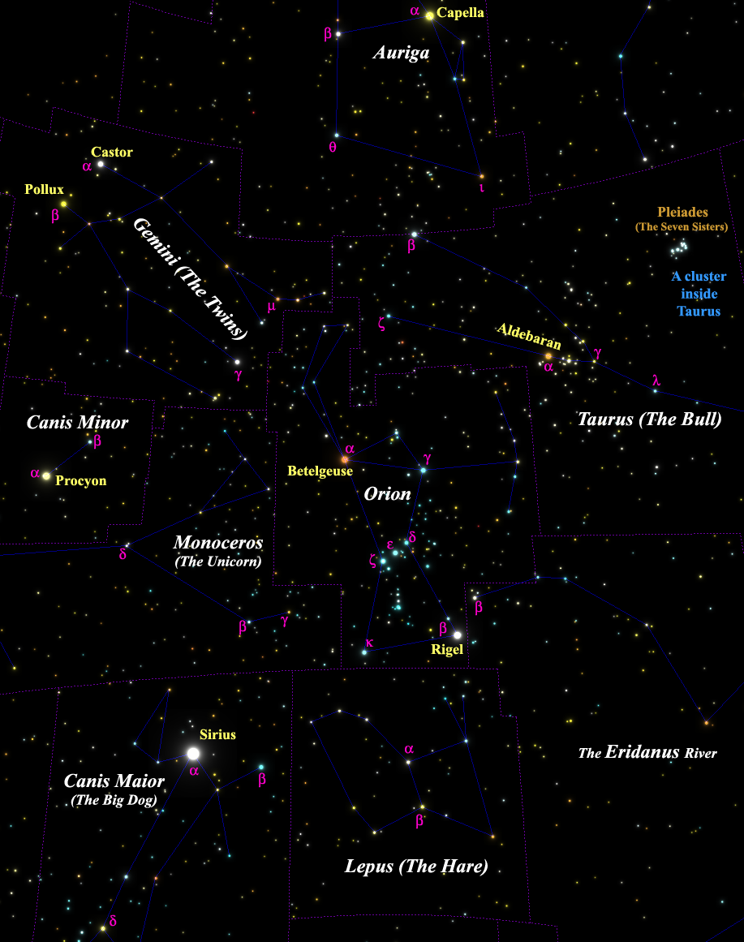
More star names - examples
Find:
Leporis
Geminorum
Tauri
A few distances:
Canis Maioris - 9 ly
β Canis Maioris - 500 ly
δ Canis Maioris - 1,800 ly
Canis Maioris - 430 ly
95% of the 5,000 naked-eye stars are at 50 to 500 ly:
in the solar neighborhood.

Slide 3
Questions coming …

Slide 4
Question 6
sec
30
29
28
27
26
25
24
23
22
21
20
18
17
16
15
14
13
12
11
10
9
8
7
6
5
4
3
2
1
0
19
What is β Canis Maioris?
A The name of a bright star.
B The name of a planet.
C The name of a constellation.
D A galaxy.
E The name of a moon revolving
around the planet α Canis Maioris.
Next question coming …

Slide 5
Question 7
sec
30
29
28
27
26
25
24
23
22
21
20
18
17
16
15
14
13
12
11
10
9
8
7
6
5
4
3
2
1
0
19
The Pleiades (the “Seven Sisters”) is …
A A constellation.
B A star.
C Not a constellation, but it is a star cluster inside
the constellation of Taurus.
D A constellation, which is the same thing as a star cluster.
E A collection of seven random stars, unrelated to each other.

