Slide 1
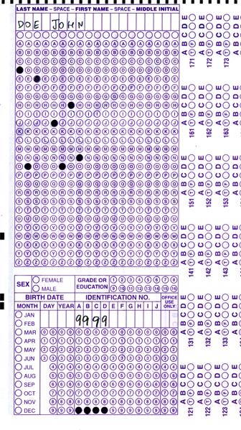

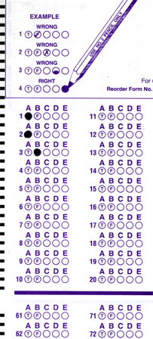
Setup:
Prepare your scantron:
Use
a pencil,
not a pen!
Fill in your name and fill the bubbles under
your name.
LAST NAME FIRST, First name second
Put your 4-digit code instead of “IDENTIFICATION NUMBER”.
--- (The last 4 digits of your OleMiss ID.)
Don’t forget: you’ll need
a new scantron for class next Monday!
Question # 1: answer A
Question # 2: answer A
Question # 3: answer E
• Labs are on
• No class on Friday
Recall reading assignment
Chapter 1, The Universe, pp. 1 – 23
(skip the math)
Please take a moment to mute your cell phone!

Slide 2
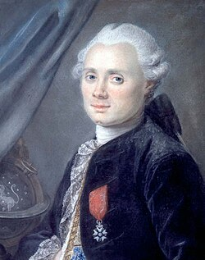
What is in the sky? – the cheat sheet
All outside the Solar System,
remember?
- Stars (in constellations)
- Everything you see is part of the Galaxy
• The glow of the Milky Way
• Stars
• Star clusters
open clusters (young, unstable)
globular clusters (old, rich)
• Planetary nebulae (dying stars’ last breath)
• Supernova remnants (star blew up)
• Diffuse nebulae (glowing interstellar gas / star formation region)
- Except: other galaxies.
Only 3 other galaxies to the naked eye:
• The Andromeda Galaxy
• The Small Magellanic Cloud (southern)
• The Large Magellanic Cloud (southern)
The
Messier
Catalog
M1 through M110
Size:
(Charles Messier 1774)
~ 10 ly
~ 100 ly
~ 1 ly
~ 10 ly
~ 100 ly

Slide 3
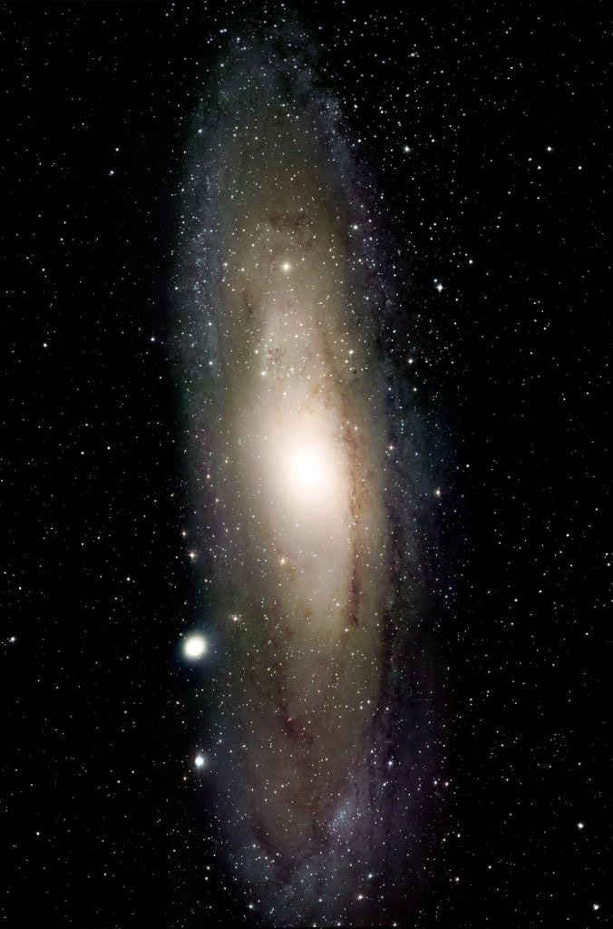
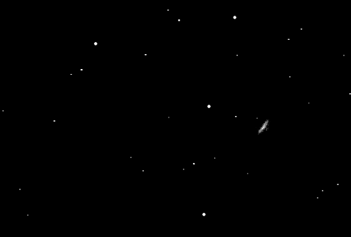
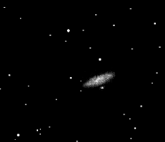
M 31 – the
Andromeda galaxy
A galaxy
With the naked eye
Photography
(20 hours)
Look in a telescope

Slide 4
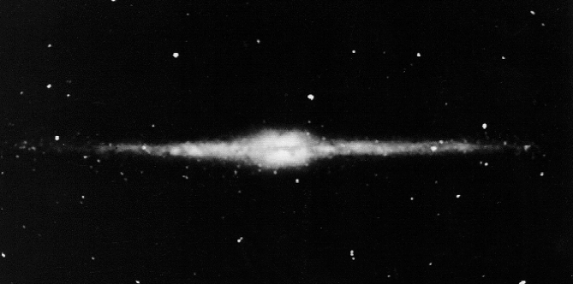
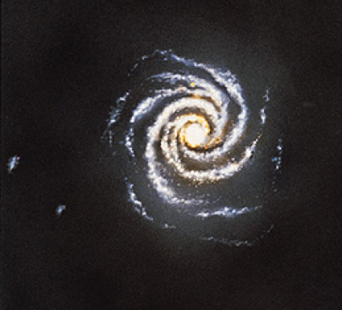
All is part of the Galaxy
All these are part of our Galaxy:
• Stars (with planets, moons, comets, …)
• Star clusters (open and globular)
• Special stars (such as one with planetary nebulae)
• Shiny and dark gas clouds
• The light of the Milky Way
A huge “star city”
of 100 billion stars
You are here: Sun and the Solar System
Everything we see in the sky is part of our Galaxy
- except other galaxies ((spirals or not)

Slide 5
Questions coming …

Slide 6
Question 4
sec
30
29
28
27
26
25
24
23
22
21
20
18
17
16
15
14
13
12
11
10
9
8
7
6
5
4
3
2
1
0
19
Which of the following, observed in the sky, may possibly not belong to our Galaxy?
A An open cluster.
B A globular cluster.
C A planetary nebula.
D A field star.
E None of these.
Next question coming …

Slide 7
Question 5
sec
30
29
28
27
26
25
24
23
22
21
20
18
17
16
15
14
13
12
11
10
9
8
7
6
5
4
3
2
1
0
19
What instrument do you need to ‘see’ the spiral arms of the Andromeda Galaxy?
A None: only your eyes.
B A pair of binoculars suffice.
C An amateur telescope at least.
D A very large, professional size telescope.
E A camera on a telescope.
Next question coming …

Slide 8
Exercises: recognize
deep-sky objects
You’ll need to answer: which of these five types
of deep-sky objects we are looking at and
how we know and what it is:
open cluster
globular cluster
galaxy
planetary nebula
diffuse nebula:
reflection nebula, HII region, dust cloud, or a combination

Slide 9
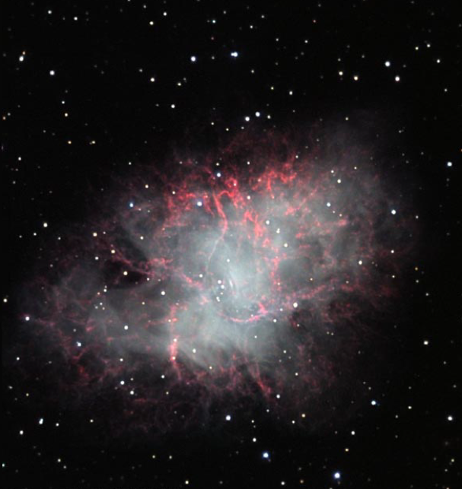
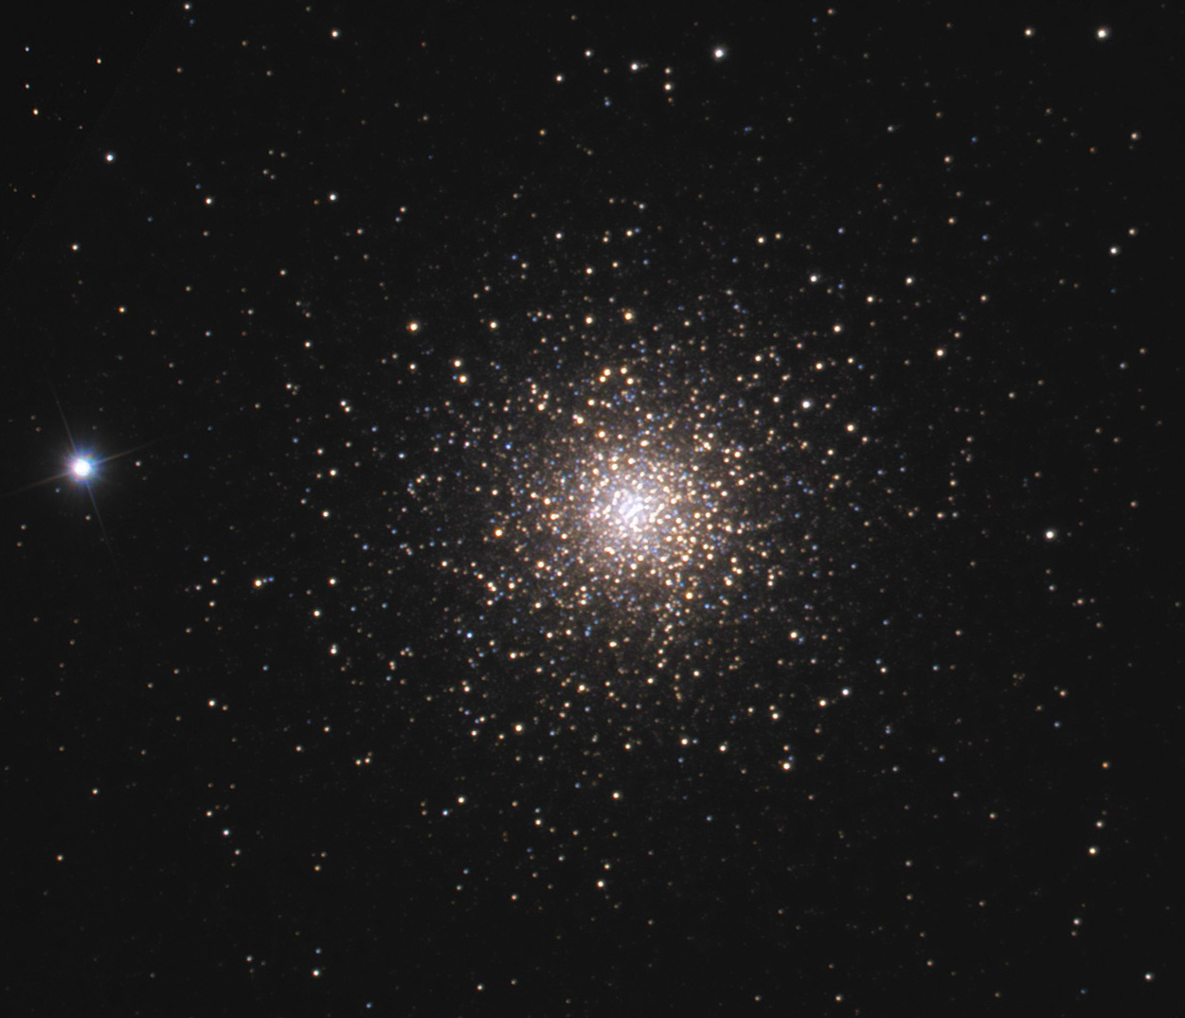
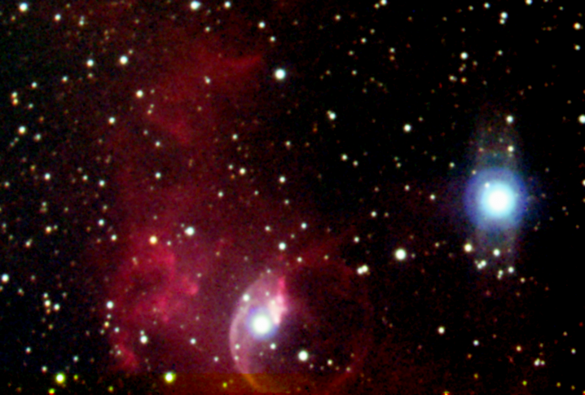
Exercise 1
What object?
Supernova remnant
Looks like result of explosion
How do we know?
What is it?
A star blew up
What object?
Globular cluster
Many stars in sphere shape
How do we know?
What is it?
Cluster of > 100,000 stars inside
the Galaxy
What object?
Diffuse nebula (HII zone)
Glowing gas illuminated by blue stars
How do we know?
Hot interstellar hydrogen gas cloud
surrounds young hot stars
What is it?

Slide 10
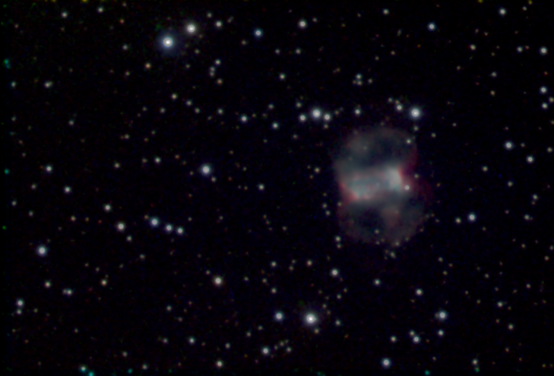
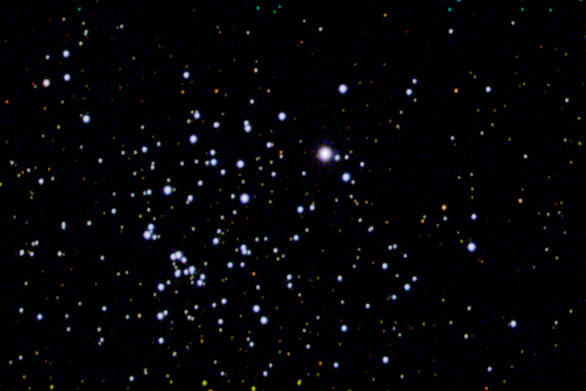
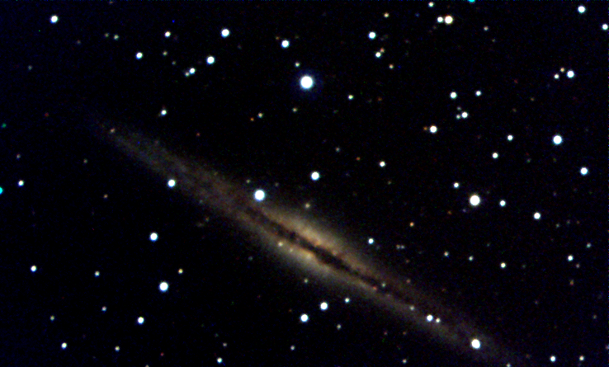
Exercise 2
What object?
Planetary nebula
One star in the middle of colorful gas
How do we know?
What is it?
Old star loosing its atmosphere to space
What object?
Open cluster
Many scattered stars
How do we know?
What is it?
Loose disintegrating cluster
of ~ 1,000 young stars
inside the Galaxy
What object?
Galaxy
Lens-shaped star system with dark lane
How do we know?
What is it?
Star system of 100 billion stars like
the Milky Way Galaxy

Slide 11
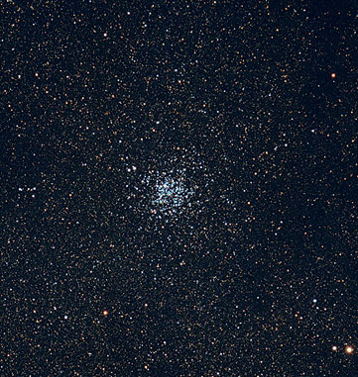
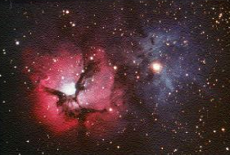
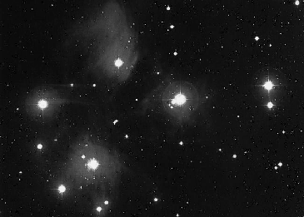
Exercise 3
What object?
Open cluster
Many scattered stars
How do we know?
What is it?
Loose disintegrating cluster of ~ 1,000
young stars inside the Galaxy
What object?
Diffuse nebula: HII region + dust clouds
Glowing gas, dark dust clouds in front
How do we know?
What is it?
Hot interstellar hydrogen with dust
blocking some of the light.
A star formation region.
What object?
Open cluster with reflection nebula
Blue cloud around bright stars
How do we know?
What is it?
Loose disintegrating cluster of ~ 1,000 young stars
inside the Galaxy, light reflected on interstellar dust.

Slide 12
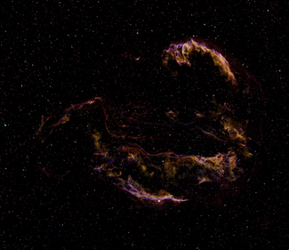
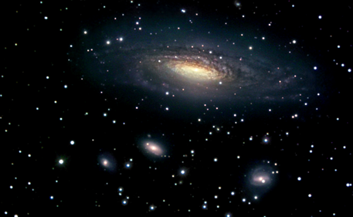
Exercise 4
What object?
Supernova remnant
How do we know?
Looks like result of explosion
Star blew up
What is it?
What object?
Galaxy
How do we know
Lens-shaped star system with
spiral arms
What is it?
Star system of 100 billion stars
like the Milky Way Galaxy

Slide 13
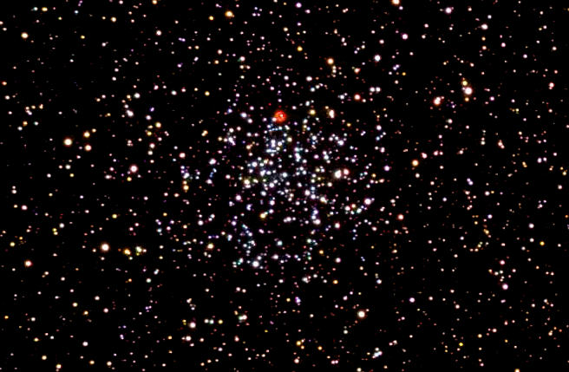
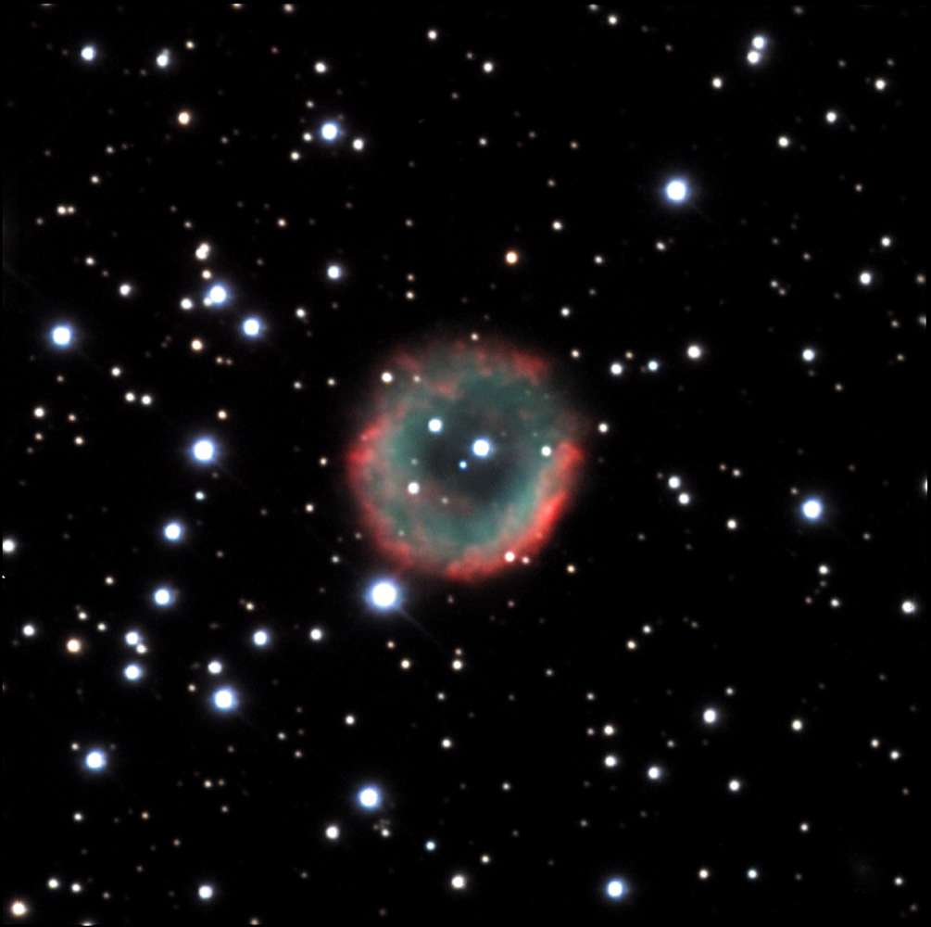
Exercise 5
What object?
Planetary nebula in front of an open cluster
How do we know?
Many scattered stars + One star in the middle of colorful gas
Loose disintegrating cluster of ~ 1,000 young stars inside the Galaxy
+ Old star loosing its atmosphere to space (unrelated,1400&5000ly)
What is it?
Insert:

