Slide 1
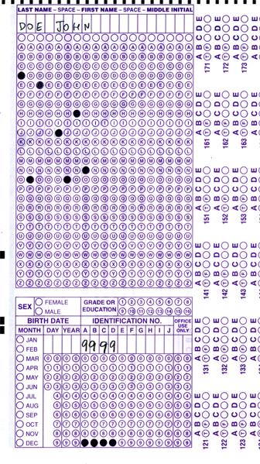


Setup:
Prepare your scantron:
Use
a pencil,
not a pen!
Fill in your name and fill the bubbles under
your name.
LAST NAME FIRST, First name second
Put your 4-digit code instead of “IDENTIFICATION NUMBER”.
--- (The last 4 digits of your OleMiss ID.)
Don’t forget: you’ll need
a new scantron for class next Wednesday!
Question # 1: answer A
Question # 2: answer A
Question # 3: answer C
• Labs are on
• No class on Friday
Recall reading assignment
Chapter 1, The Universe, pp. 1 – 23
(skip the math)
Please take a moment to mute your cell phone!

Slide 2
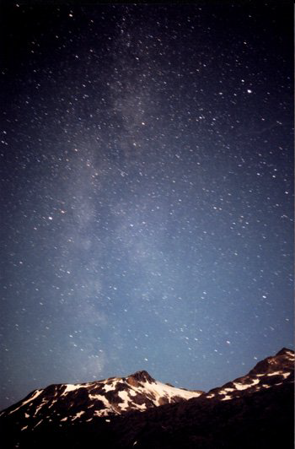
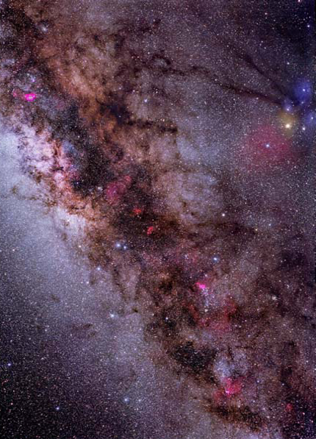
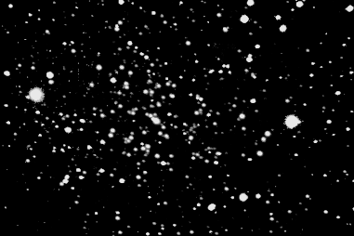
An observational perspective on real astronomy.
Stars are always dots in the telescope:
(5000 with the naked eye)
Star with naked eye:
Star in a telescope:
Must analyze spectrum (color) of stars to learn about them - a hard job!
All else in the sky is faint: “deep sky” objects
Must collect light for a long time with large telescopes - a hard job!
Photography
(30 minutes)
With the
naked eye
The
Milky
Way
Look in a telescope

Slide 3
Questions coming …

Slide 4
Question 4
sec
30
29
28
27
26
25
24
23
22
21
20
18
17
16
15
14
13
12
11
10
9
8
7
6
5
4
3
2
1
0
19
How does a star look in a good telescope?
A A large disk with swirls of hot gas visible on it.
B A large disk with mountains and rivers visible on it.
C A large disk with clouds visible on it.
D A small disk with a few starspots.
E A dot.
Next question coming …

Slide 5
Question 5
sec
30
29
28
27
26
25
24
23
22
21
20
18
17
16
15
14
13
12
11
10
9
8
7
6
5
4
3
2
1
0
19
How many stars are visible with the naked eye
(total, in the whole sky)?
A 300
B 5000
C 3 million
D 14 billion
E It has not been counted yet: more than trillions.
Next question coming …

Slide 6
Question 6
sec
30
29
28
27
26
25
24
23
22
21
20
18
17
16
15
14
13
12
11
10
9
8
7
6
5
4
3
2
1
0
19
Is the Milky Way visible to the naked eye
in a dark location?
A No. We need large telescopes to see the
Milky Way at all.
B No, but a pair of binoculars is sufficient to see it.
C Barely.
D As a faint and tiny patch of glow.
E As a band of light all the way around the sky.
Next question coming …

Slide 7
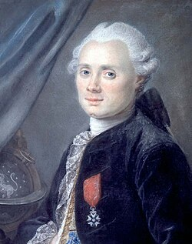
What is in the sky?
All outside the Solar System,
remember?
- Stars (in constellations)
- Everything you see is part of the Galaxy
• The glow of the Milky Way
• Stars
• Star clusters
open clusters (young, unstable)
globular clusters (old, rich)
• Planetary nebulae (dying stars’ last breath)
• Supernova remnants (star blew up)
• Diffuse nebulae (glowing interstellar gas / star formation region)
- Except: other galaxies.
Only 3 other galaxies to the naked eye:
• The Andromeda Galaxy
• The Small Magellanic Cloud (southern)
• The Large Magellanic Cloud (southern)
The
Messier
Catalog
M1 through M110
Size:
(Charles Messier 1774)
~ 10 ly
~ 100 ly
~ 1 ly
~ 10 ly
~ 100 ly

Slide 8
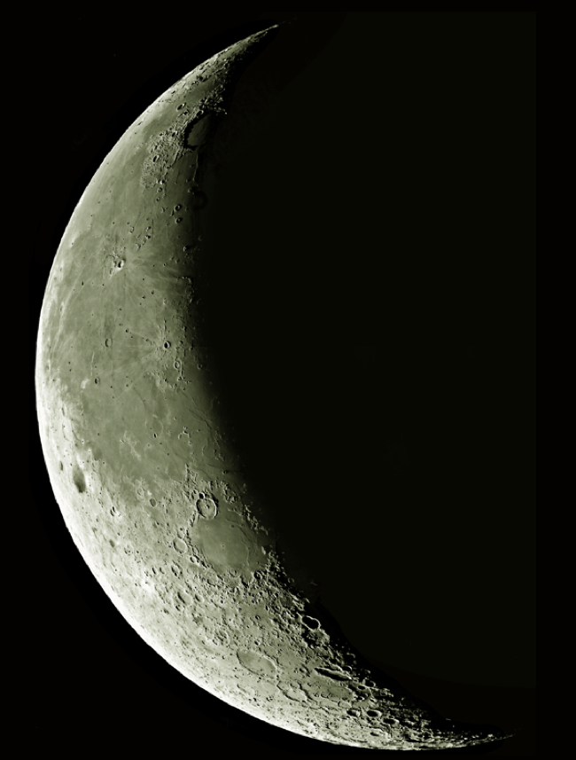
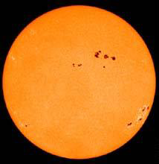
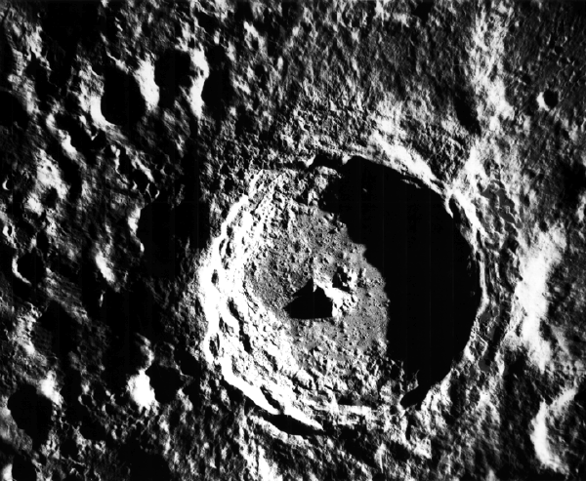
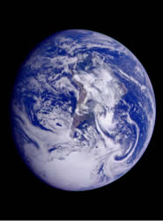
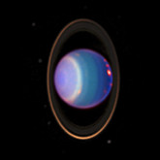
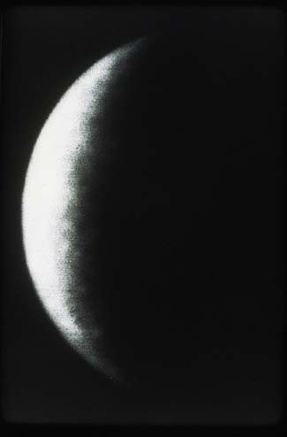
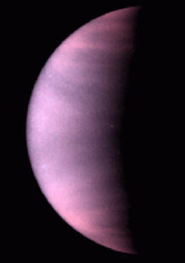
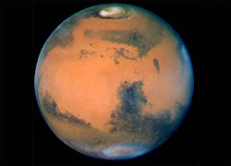
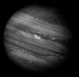
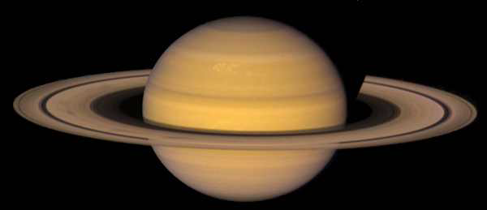
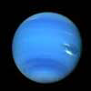
Solar System
… and there is the Solar System of course.
This is what you would see in a very good telescope.
Sun
Moon
Mercury Venus Earth Mars Jupiter Saturn Uranus Neptune

Slide 9
Questions coming …

Slide 10
Question 7
sec
30
29
28
27
26
25
24
23
22
21
20
18
17
16
15
14
13
12
11
10
9
8
7
6
5
4
3
2
1
0
19
Which of the following is not a deep-sky object?
A A galaxy.
B A star cluster.
C A very dim star.
D A planetary nebula.
E A supernova remnant.
Next question coming …

Slide 11
Question 8
sec
30
29
28
27
26
25
24
23
22
21
20
18
17
16
15
14
13
12
11
10
9
8
7
6
5
4
3
2
1
0
19
The Messier catalog is a list of what?
A Stars.
B Deep sky objects.
C Comets.
D Nebulae.
E Star clusters.

Slide 12
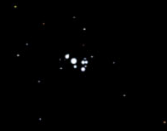
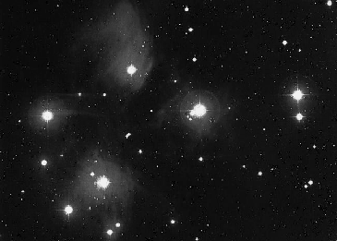
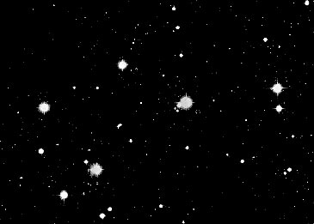
M45 the Pleiades – the Seven Sisters
Open star cluster
(notice the unusual reflection from dust)
With the naked eye
(young, disintegrating cluster))
Photography (5 hours)
Look in a telescope

Slide 13
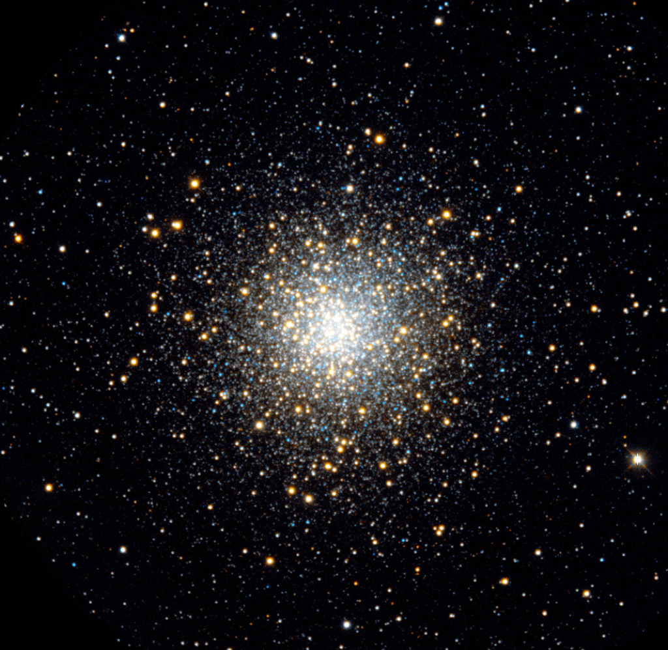
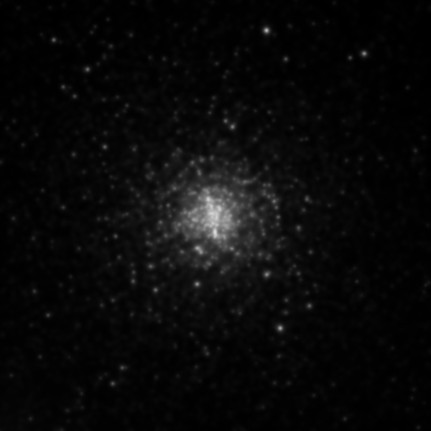
M13 – the Hercules cluster
Globular star cluster
(old, stable, rich cluster))
With the naked eye
Photography (5 hours)
Look in a telescope

Slide 14
Questions coming …

Slide 15
Question 9
sec
30
29
28
27
26
25
24
23
22
21
20
18
17
16
15
14
13
12
11
10
9
8
7
6
5
4
3
2
1
0
19
Which one is larger –
an open cluster or a globular cluster?
A Both types are the same size, about a million light years.
B Both types are the same size, about a thousand light years.
C A globular is ~ 100 ly, an open cluster is ~ 10 ly.
D A globular is ~ 10 ly, an open cluster is ~ 100 ly.
E A globular is ~ 10000 ly, an open cluster is ~ 10 ly.
Next question coming …

Slide 16
Question 10
sec
30
29
28
27
26
25
24
23
22
21
20
18
17
16
15
14
13
12
11
10
9
8
7
6
5
4
3
2
1
0
19
Which one is young, which one is old?
A Globular cluster – old, open cluster - young.
B Globular cluster – young, open cluster - old.
C Both types may be old or young.
D Both types are young as stars go.
E Both types are old as stars go.

Slide 17
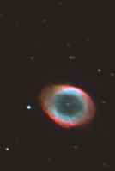
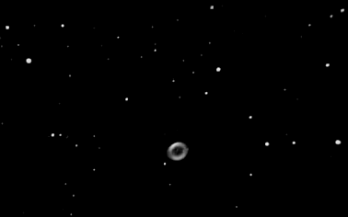
M 57 – the Ring Nebula
A planetary nebula
(the last breath of a dying star)
With the naked eye
Photography
(90 minutes)
Look in a telescope
(Picture taken in
Kennon
by two students)

Slide 18
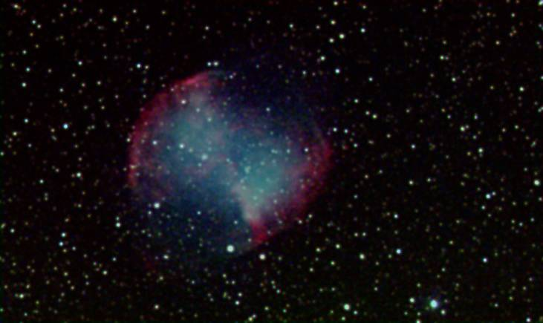
M 27 - ours
The Dumbell – another planetary nebula
(M 27)

Slide 19
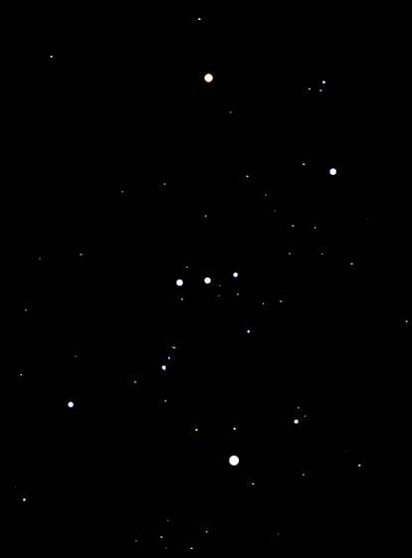
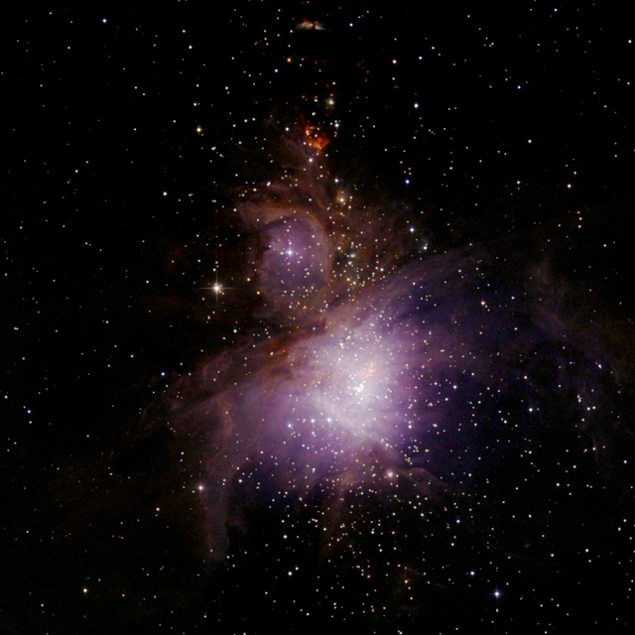
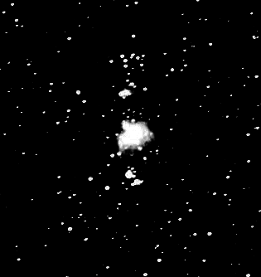
M42 – the Orion Nebula
With the naked eye
Diffuse nebula
Gas and dust cloud, illuminated by hot stars
(star formation region)
Photography (1 hour)
Look in a telescope

Slide 20
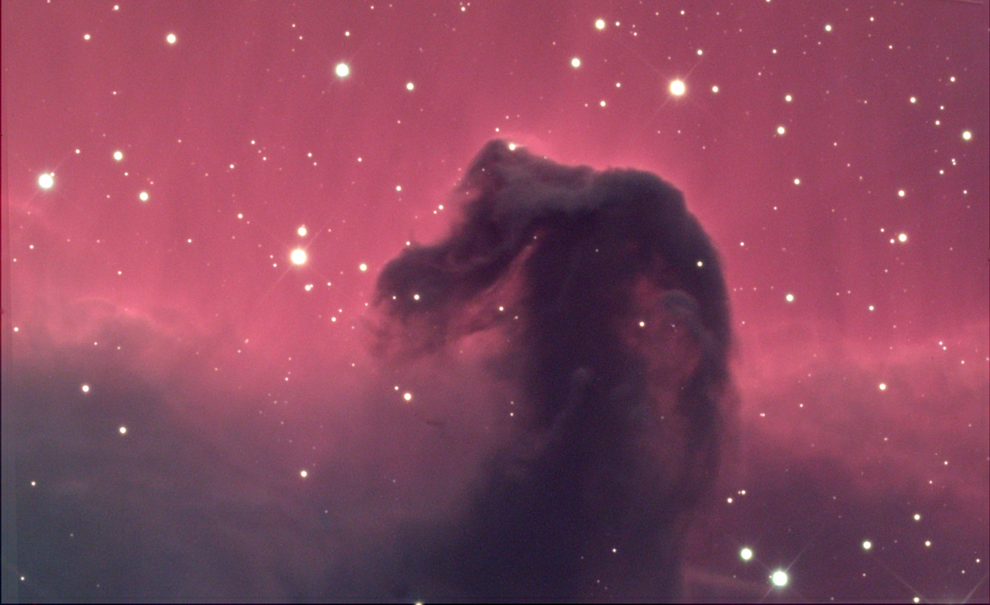
The Horsehead
With the naked eye:
A diffuse nebula
Look in a telescope:
Photo-
graphy
(10 hours)

Slide 21
Questions coming …

Slide 22
Question 11
sec
30
29
28
27
26
25
24
23
22
21
20
18
17
16
15
14
13
12
11
10
9
8
7
6
5
4
3
2
1
0
19
New stars are formed in …
A planetary nebulae
B diffuse nebulae
C open clusters
D globular clusters
E diffuse and planetary nebulae
Next question coming …

Slide 23
Question 12
sec
30
29
28
27
26
25
24
23
22
21
20
18
17
16
15
14
13
12
11
10
9
8
7
6
5
4
3
2
1
0
19
A planetary nebula is …
A an object that orbits a star
B as large as 100 light years
C young as stars go
D old as stars go
E the result of a star blowing up

Slide 24
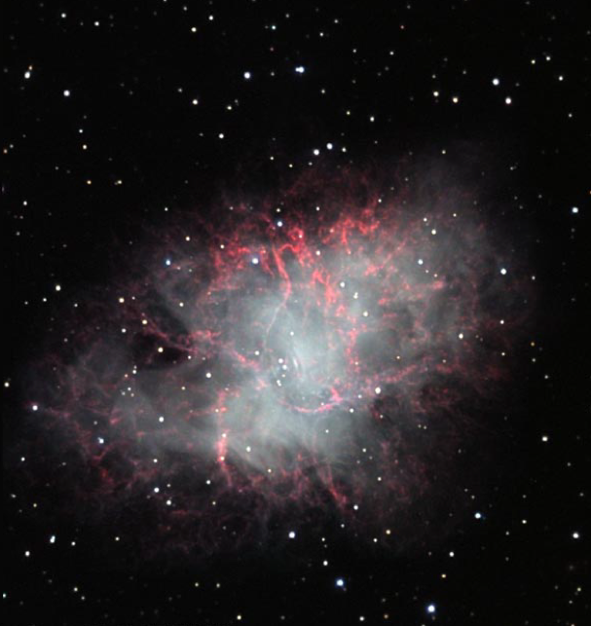
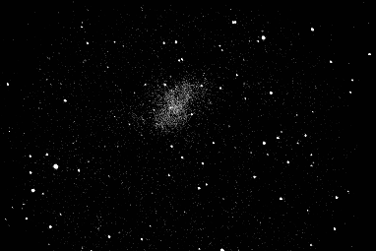
M 1
M1 - The Crab Nebula
A supernova remnant
a star blew up, 1054 AD
(the only one visible in a telescope)
With the naked eye
Photography
(10 hours)
Look in a telescope

Slide 25
Question 13
sec
30
29
28
27
26
25
24
23
22
21
20
18
17
16
15
14
13
12
11
10
9
8
7
6
5
4
3
2
1
0
19
How many supernova remnants are visible in the sky
in a telescope?
(by visual observation, not photography)
A None.
B One.
C A handful.
D Thousands.
E Millions.

