Slide 1
Remnants
Stars: losing fight against gravity.
Balance: gravity against radiation pressure – while fuel lasts
When fuel gone,
● atoms touch – white dwarf
(mass < 1.44 solar)
● atoms crushed, nuclei touch – neutron star
(1.44 solar < mass < 10 solar)
● nothing can balance gravity – black hole
(10 solar < mass)
Earth-size
(Example: Sirius B)
Extremely
dense
stable
remnants
Ten miles size
A few miles size
● or nothing, if it all flies apart.

Slide 2
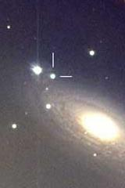
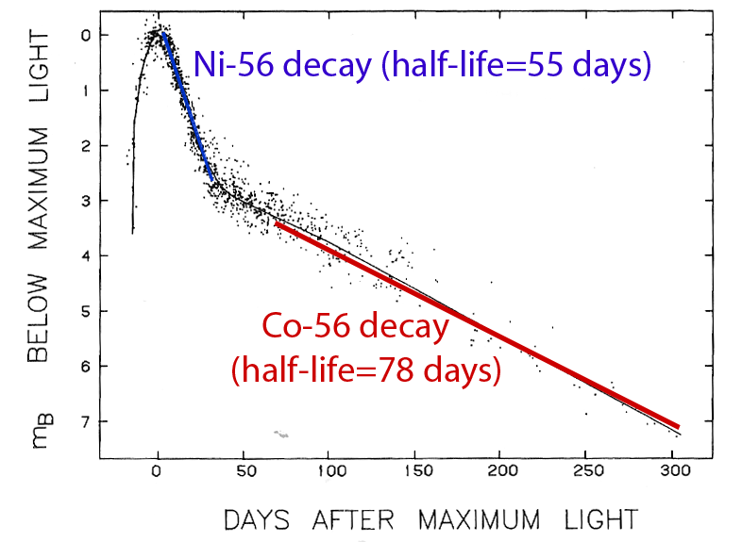
Supernova light curve
A very bright star appears in a distant galaxy,
shines for a few months, then slowly fades away
Energy source of fading supernova is the decay
Proof that heavy elements originate in supernovae!

Slide 3
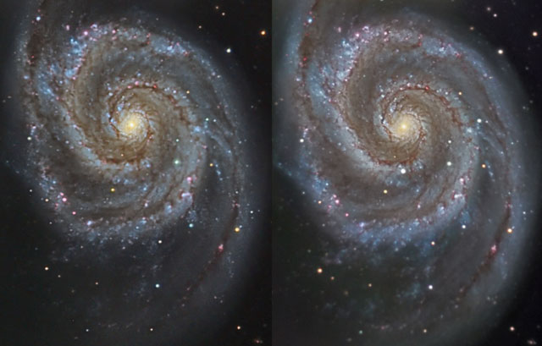
Supernova in M51
8 hours of total exposures, 12 in Takahashi f/9 telescope

Slide 4
Questions coming …

Slide 5
Question 10
sec
30
29
28
27
26
25
24
23
22
21
20
18
17
16
15
14
13
12
11
10
9
8
7
6
5
4
3
2
1
0
19
What determines what sort of an object
remains after a dead star?
A The temperature of the star.
B The chemical composition of the star.
C The mass of the star.
D The brightness of the star.
Next question coming …

Slide 6
Question 11
sec
30
29
28
27
26
25
24
23
22
21
20
18
17
16
15
14
13
12
11
10
9
8
7
6
5
4
3
2
1
0
19
In a white dwarf,
A Atoms are far apart from each other.
B Atoms are not broken up, but touch.
C Atoms are crushed into each other, atomic nuclei touch.
D There is nothing to withstand gravity, the star
has completely collapsed.

Slide 7
Question 12
sec
30
29
28
27
26
25
24
23
22
21
20
18
17
16
15
14
13
12
11
10
9
8
7
6
5
4
3
2
1
0
19
What is a supernova?
A A Sun-sized star blowing up.
B A very heavy star blowing up.
C A very large and very old star.
D A newly born star.
E A new planet.

