Slide 1



Setup:
Prepare your scantron:
Use
a pencil,
not a pen!
Fill in your name and fill the bubbles under
your name.
LAST NAME FIRST, First name second
Put your 4-digit code instead of “IDENTIFICATION NUMBER”.
--- (The last 4 digits of your OleMiss ID.)
Pass/Fail makeup: April 10, 2:00 pm
(in Lewis Hall basement lab)
Question # 1: answer A
Question # 2: answer C
Question # 3: answer D
Reading assignments
The Stellar Graveyard, Chapter 18, pp. 557-579
Please take a moment to mute your cell phone!

Slide 2
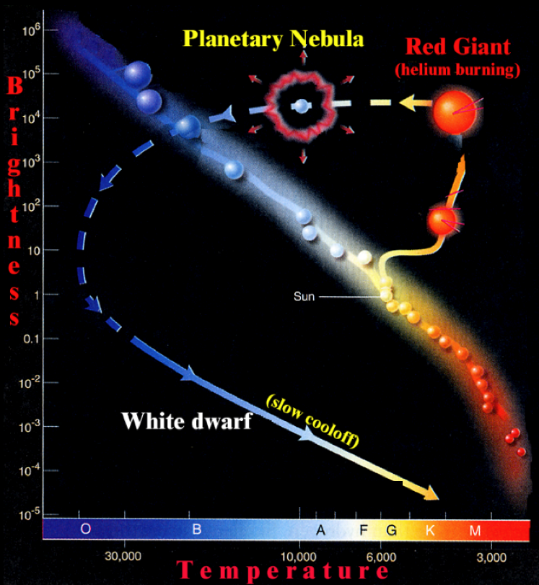
Stellar evolution (Sun-like)
Stellar
Evolution
Recall the evolution
of
Sun-like stars
(Mass < 1.44 M)
AGB
AGB
(asymptotic giant branch)
• Huge envelope
• Strong stellar wind
• Mass loss (more than half of the star’s mass)

Slide 3
Review questions coming …

Slide 4
Question 4
sec
45
40
35
30
25
19
18
17
16
15
14
13
12
11
10
9
8
7
6
4
3
2
1
0
20
This question
counts double!
5
45
What is the correct sequence of the evolution
of the Sun?
A Main sequence, red giant, supernova.
B Main sequence, red dwarf.
C Main sequence, supernova.
D Main sequence, red giant, planetary nebula, white dwarf.
E Red giant, main sequence, white dwarf.
Next question coming …

Slide 5
Question 5
sec
45
40
35
30
25
19
18
17
16
15
14
13
12
11
10
9
8
7
6
4
3
2
1
0
20
This question
counts double!
5
45
What will be the Sun’s chemical composition after
all its evolution is over?
A Hydrogen and Helium.
B Carbon-Nitrogen-Oxigen.
C Iron.
DA mix of heavy chemical elements (such as Pb, U, Cu, … .)
E Nothing: the Sun will blow up and vanish.

Slide 6
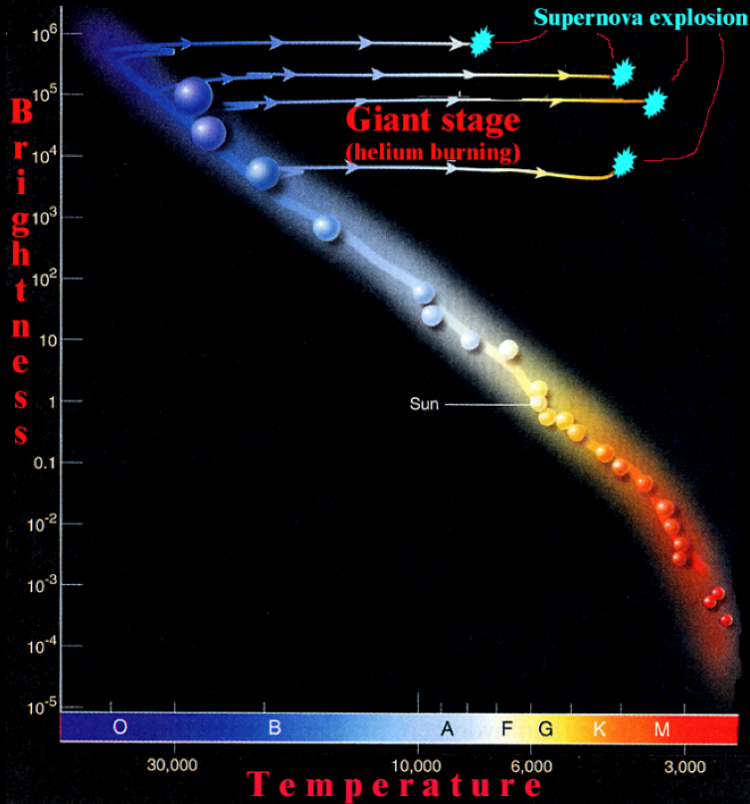
Stellar evolution (massive)
Stellar
Evolution
Evolution
of
massive stars
(Mass > 1.44 M)

Slide 7
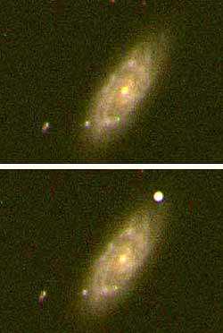
Heavy stars:
when center is all iron,
blow up as supernovae
(further fusion would not produce more heat):
No more heat is produced to hold up against gravity
core collapses
blows up
during blowup, all heavier elements
are produced
“Heavy” means
Mass > 1.44 Solar Masses
The Chandrashekar limit.
SUPERNOVA
Outshines a whole galaxy (for a few days)
All heavy elements
(anything heavier than iron)
come from SN explosions!

Slide 8
Questions coming …

Slide 9
Question 6
sec
30
29
28
27
26
25
24
23
22
21
20
18
17
16
15
14
13
12
11
10
9
8
7
6
5
4
3
2
1
0
19
What is a supernova?
A A new planet.
B A planet blowing up.
C A newly born star.
D A Sun-sized star blowing up.
E A larger-than-the-Sun star blowing up.
Next question coming …

Slide 10
Question 7
sec
30
29
28
27
26
25
24
23
22
21
20
18
17
16
15
14
13
12
11
10
9
8
7
6
5
4
3
2
1
0
19
Which stars end their lives blow up as supernovae?
A Those that are heavier than 1.4 times the Sun.
B All.
C Only a few exceptional stars.
D Supernovae are not blowing-up stars at all.
E Only double stars.

Slide 11
Pathways
Evolutionary pathways and the production of chemical elements
Sun-like stars (mass < 1.44 solar): timeline for 1 solar mass
1. H → He on the main sequence 10 billion years
2. He → C, O, Si, …, Fe in hot core of red giant 1 billion years
3. Planetary nebula thrown off 10,000 years
4. White dwarf cooling off “forever”
Gas thrown off will become part of newly born stars
(a mix of all chemical elements, but not the heavy ones)
Heavy stars (mass > 1.44 solar): timeline for 10 solar mass
1. H → He on the main sequence 10 million years
2. He → C, O, Si, …, Fe in hot core of red giant 1 million years
3. Supernova explosion (Au, Ag, Pb, U, … built) 10 seconds
4. Tiny but very dense remainder cooling off “forever”
(pulsar or black hole or nothing at all)
Gas thrown off will become part of newly born stars
(a mix of all chemical elements, including heavy ones)

Slide 12
Questions coming …

Slide 13
Question 8
sec
45
40
35
30
25
19
18
17
16
15
14
13
12
11
10
9
8
7
6
4
3
2
1
0
20
5
45
How long is the ‘lifetime’ of a very large and a very
small star and how does it end?
 | Mass (Solar masses) | Lifetime (years) | Ends in …
A | 100 0.1 | 100 billion 1 million | Supernova White dwarf
B | 100 0.1 | 100 billion 1 million | White dwarf Supernova
C | 100 0.1 | 1 million 100 billion | White dwarf Supernova
D | 100 0.1 | 1 million 100 billion | Supernova White dwarf
E | 100 0.1 | 1 million 100 billion | Supernova Supernova
Next question coming …

Slide 14
Question 9
sec
30
29
28
27
26
25
24
23
22
21
20
18
17
16
15
14
13
12
11
10
9
8
7
6
5
4
3
2
1
0
19
Where have the gold, found on Earth, been formed?
A is a white dwarf.
B in the Sun.
C in a red giant.
D in an exploding supernova.
E inside Earth.

