Slide 1
HRD1
Put all measured data of a star together
Look for relationships
For the closeby stars we can measure:
• Brightness (m)
• Parallax → Calculate distance
• Color → Calculate temperature (T)
Calculate
absolute brightness (M)
and make a graph of M vs. T

Slide 2
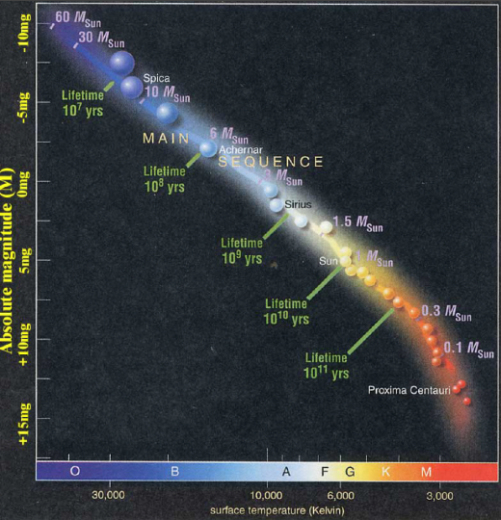
HRD2
The Herzsprung-Russel diagram
(HRD)
• relates spectral type to absolute magnitude
• is the main tool or understanding stars
• The majority (but not all!) stars are on the “main sequence”

Slide 3
HRD3
A simple use of HRD: determine “spectroscopic parallax”
Procedure:
• Measure the color of a star
• Use HRD to read off its absolute magnitude
• Measure its apparent magnitude
• Calculate distance modulus
→ calculate distance
The good new is:
This method will work
for stars that are
not close to us!

Slide 4
Questions coming …

Slide 5
Question 7
sec
30
29
28
27
26
25
24
23
22
21
20
18
17
16
15
14
13
12
11
10
9
8
7
6
5
4
3
2
1
0
19
What two things are related by the Hertzsprung-Russel
diagram (HRD)?
A The absolute brightness and the temperature of stars.
B The size and the absolute brightness of stars.
C The apparent brightness and the spectral type of the star.
D The size and the apparent brightness of a star.
Next question coming …

Slide 6
Question 8
sec
45
40
35
30
25
19
18
17
16
15
14
13
12
11
10
9
8
7
6
4
3
2
1
0
20
5
45
How do we determine the distance of stars that are
too far for the parallax method to work?
A Measure how many years light takes to come to us.
B Use the HRD to find the absolute magnitude (M),
than compare it to the apparent magnitude (m).
C Find the temperature of the star on the HRD, than
compare it with the color of the star.
D Measure how large the star’s disk looks in the telescope.
Next question coming …

Slide 7
Question 9
sec
45
40
35
30
25
19
18
17
16
15
14
13
12
11
10
9
8
7
6
4
3
2
1
0
20
5
45
Would the Sun be visible without a telescope from a distance of 10 parsec?
A It would look as bright as the full Moon from Earth.
B It would look like a very bright star.
C It would be just visible to the naked eye.
D It would be visible only with a very large telescope.
E It would look too faint to see with any telescope at all.

Slide 8
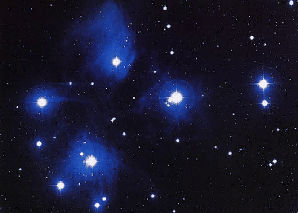
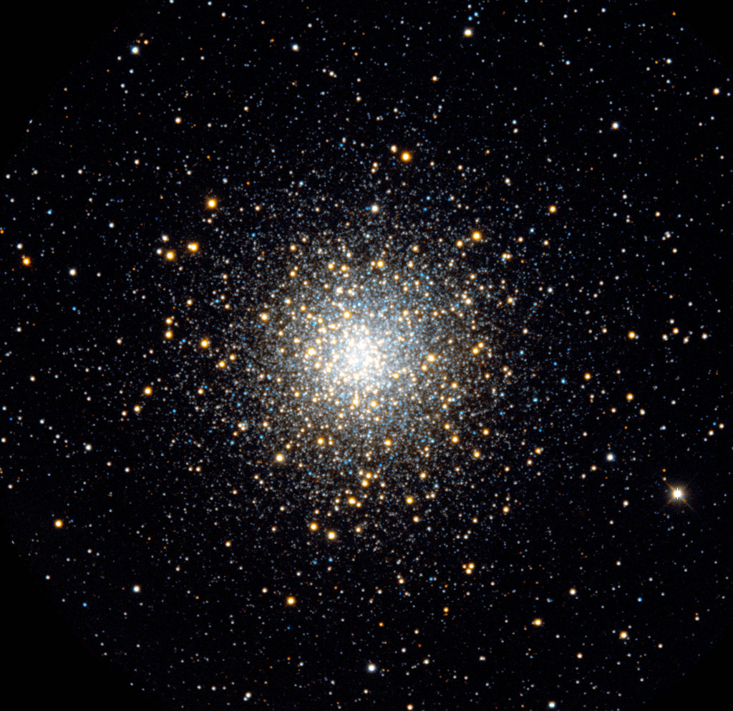
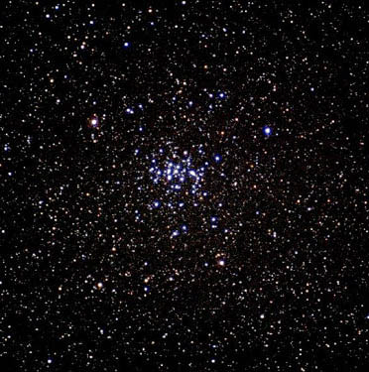
Use for clusters
An application: star clusters
Recall what they are: a bunch of stars together
• close to each other (less than a light year)
• all part or our Galaxy
The Pleiades
(M45)
A globular cluster
(M10)
The Beehive
(M44)
Two open clusters

Slide 9
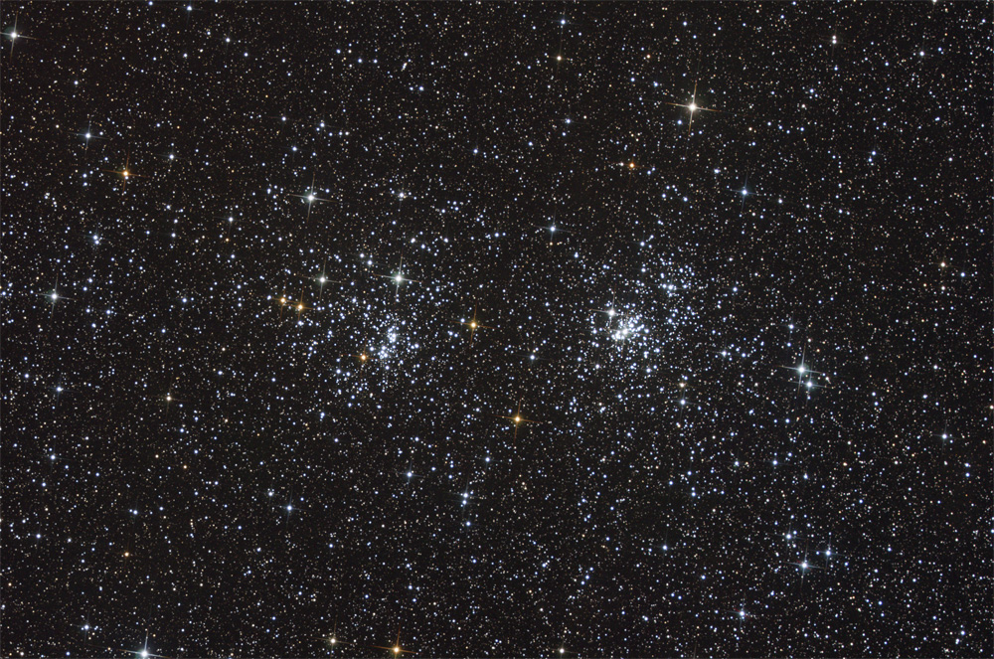

Slide 10
Questions coming …

Slide 11
Question 10
sec
30
29
28
27
26
25
24
23
22
21
20
18
17
16
15
14
13
12
11
10
9
8
7
6
5
4
3
2
1
0
19
What is a star cluster made of?
A Galaxies.
B It is a cloud of gas.
C Many stars.
D Interstellar dust.
Next question coming …

Slide 12
Question 11
sec
30
29
28
27
26
25
24
23
22
21
20
18
17
16
15
14
13
12
11
10
9
8
7
6
5
4
3
2
1
0
19
Which one contains more stars, an open cluster or a globular cluster?
A An open cluster.
B A globular cluster.
C The same.
D Neither, because both are gas clouds.

