Slide 1


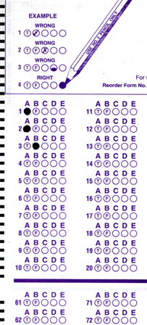
Setup:
Prepare your scantron:
Use
a pencil,
not a pen!
Fill in your name and fill the bubbles under
your name.
LAST NAME FIRST, First name second
Put your 4-digit code instead of “IDENTIFICATION NUMBER”.
--- (The last 4 digits of your OleMiss ID.)
Question # 1: answer A
Question # 2: answer C
Question # 3: answer B
Reading assignment
Stars, Chapter 15, pp. 488-512
Please take a moment to mute your cell phone!

Slide 2
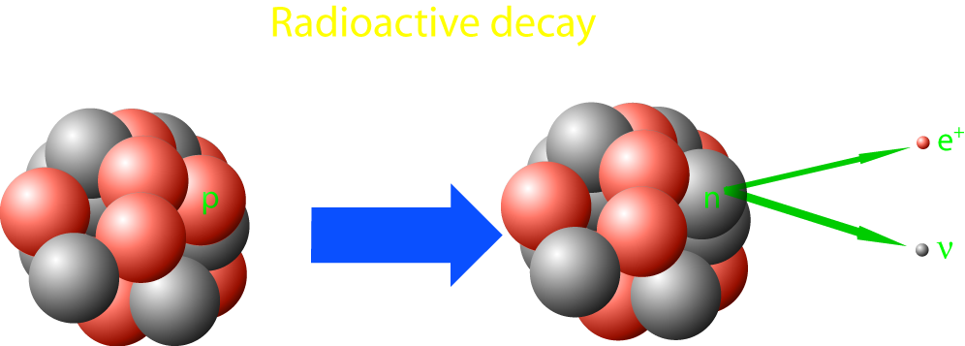
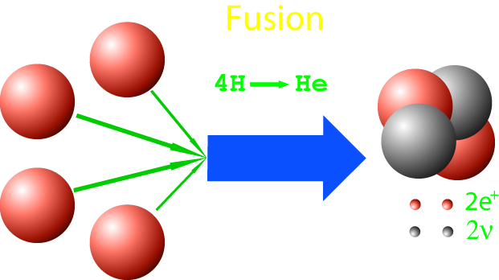
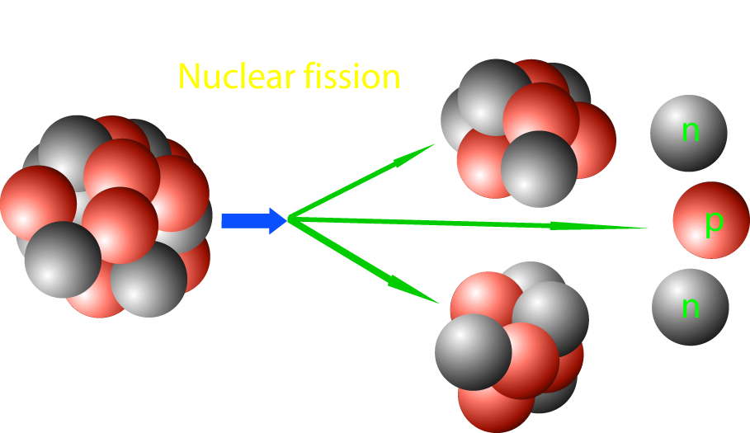
Nuclear processes
Nuclear processes
Decay (occurs in nature)
Fission (Reactors & A-bomb)
Fusion (H-bomb)
Don’t confuse with chemical processes!
They don’t change one atom into another.

Slide 3
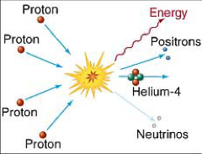
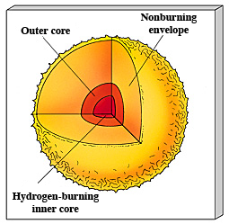
Hydrogen to helium fusion
In the Sun:
This reaction needs
heat > 1 million K
(only in the very center of a star!)
4 H → He + heat
(Call it H ‘burning’ - it is really not!)
Mass of
1 proton 1.00867 units
4 protons 4.03468 units
1 He 4.00260 units
Missing 0.03208 units = 0.8%
Becomes energy of heat:
E = m c²

Slide 4
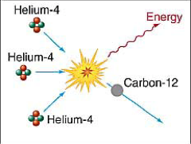
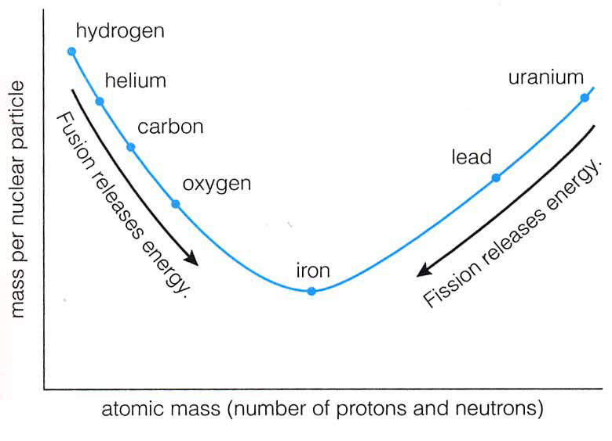
”Metals” build up
• More processes - helium fusion and beyond
He + He + He → C + heat
He + C → O + heat
...
• These processes need
hotter and hotter temperatures
Not in the Sun yet!
• Energy is produced by fusion
of heavier elements up to iron
A-bomb does this
Stars do this

Slide 5
Questions coming …

Slide 6
Question 4
sec
30
29
28
27
26
25
24
23
22
21
20
18
17
16
15
14
13
12
11
10
9
8
7
6
5
4
3
2
1
0
19
What keeps the Sun hot?
A It burns hydrogen into water.
B It produces helium from hydrogen.
C It produces heavier elements from helium.
D It is hot and cooling slowly as it gives off its heat.
Next question coming …

Slide 7
Question 5
sec
30
29
28
27
26
25
24
23
22
21
20
18
17
16
15
14
13
12
11
10
9
8
7
6
5
4
3
2
1
0
19
Where in the Sun is there heat production?
A Everywhere.
B Only in the center.
C Nowhere. The Sun in only giving off its existing heat.
D Only on the surface.
Next question coming …

Slide 8
Question 6
sec
30
29
28
27
26
25
24
23
22
21
20
18
17
16
15
14
13
12
11
10
9
8
7
6
5
4
3
2
1
0
19
Which of the following uses the same physical process as the Sun to generate heat?
A A gas stove.
B A wood stove.
C A hydrogen bomb.
D An atomic bomb.
E A nuclear reactor.

