Slide 1


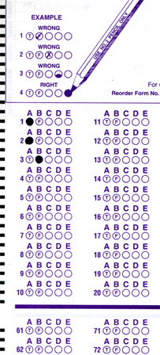
Setup:
Prepare your scantron:
Use
a pencil,
not a pen!
Fill in your name and fill the bubbles under
your name.
LAST NAME FIRST, First name second
Put your 4-digit code instead of “IDENTIFICATION NUMBER”.
--- (The last 4 digits of your OleMiss ID.)
Reading assignment
Star Stuff, Chapter 17, pp. 534-556
Question # 1: answer A
Question # 2: answer C
Question # 3: answer A
NOTE: Pass/fail test on Friday, Mar. 27!!
Please take a moment to mute your cell phone!

Slide 2
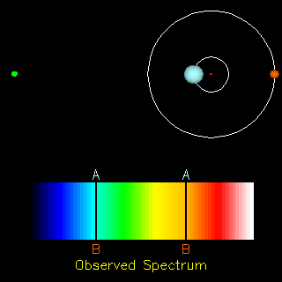
Spectroscopic binaries: orbit too close to separate
Measure:
* Blue/red shift of lines
* Time period
Earth
Calculate:
* Orbital speed
( shift in % of wavelength
= speed in % of speed of light )
* Size of orbit
( time period × speed = 2 r π )
* Mass of stars
( Kepler III: M × T² = r³ )

Slide 3
Double stars:
- Apparent doubles (at different distances)
- Common proper motion systems (not gravitationally bound)
- Binaries (orbit around common center):
- Orbiting too slowly to be seen moving (T>>100 yrs)
- Orbital period noticeable (T~10-100 yrs)
[a ~ 1-100 AU, d<100 ly] – only a few systems
- Too close to resolve (spectrosopic binaries)
~ 50% of stars are doubles.

Slide 4
The mass of stars
:
use binaries
(spectroscopic or not)
Measure:
a
Period (T) in years
Size of orbit (a) in AU’s
Kepler’s III law tells mass:
M T² = a³
solve this for M
Example:
A binary system has been measured to turn around in 55 years
Stars separated 3 arc second
Parallax is 0.067 arc second.
Use these data to figure out the system:
Distance to stars from parallax: 15 parsecs
a = 45 AU and T = 55 years, plug in and solve equation
mass = 30 solar masses (very big stars)

Slide 5
Questions coming …

Slide 6
Question 4
sec
30
29
28
27
26
25
24
23
22
21
20
18
17
16
15
14
13
12
11
10
9
8
7
6
5
4
3
2
1
0
19
Why are double stars important in astronomy?
A They help us to measure the distance to stars.
B They provide the only way to measure the mass of the stars.
C They help us find out what substances stars are made of.
D They help us find out how fast stars revolve around the center of the Galaxy.
Next question coming …

Slide 7
Question 5
sec
30
29
28
27
26
25
24
23
22
21
20
18
17
16
15
14
13
12
11
10
9
8
7
6
5
4
3
2
1
0
19
How do we know the mass of (some) stars?
A Using measurements of their planets.
B Using measurements of the force of their gravity on spaceships.
C Using the red/blue shift of spectral lines of binary stars.
D Using measurements of their brightness and color.

Slide 8
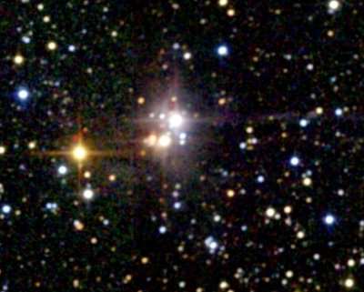
The spectral type (color) of stars
Stars come in color:
The human eye can’t see the color of faint objects
We see the color of the brightest stars only
But the color is still there
Photos bring it out
What makes stars colored?
Temperature
Wien’s law:
Hot objects glow,
the color of their light changes
from red to blue as they get hotter:
Temperature [K] = 2880 / wavelength [μm]
(Wilhelm Wien, 1896)
The color of stars is described by the spectral type:
O , B, A, F, G, K, M
Blue (40,000 deg)
Red (1000 deg)
White (10,000 deg)
Yellow (6000 deg): like THE SUN

Slide 9
Questions coming …

Slide 10
Question 6
sec
30
29
28
27
26
25
24
23
22
21
20
18
17
16
15
14
13
12
11
10
9
8
7
6
5
4
3
2
1
0
19
Can we see the color of the stars in the sky
(without a telescope)?
A No, because stars do not have color.
B No, because the human eye cannot see the stars’ color.
C Only of the brightest stars.
D Yes, all stars can be seen in color by the human eye.
Next question coming …

Slide 11
Question 7
sec
30
29
28
27
26
25
24
23
22
21
20
18
17
16
15
14
13
12
11
10
9
8
7
6
5
4
3
2
1
0
19
What does Wien’s law say?
A That the color of the stars is related to the temperature of the star.
B That stars come in different colors.
C That there are seven spectral types of stars.
D That hotter stars are brighter.
E That a red star is brighter than a blue star.

Slide 12
Stars: temperature - examples
Wien’s law: color - temperature relationship
Temperature [K] = 2880 / wavelength [μm]
(photospheric temperature)
Examples:
Sun yellow (500 nm) T → 6,000 degrees
Sirius white (300 nm) T → 10,000 degrees
Betelgeuse red (1000 nm) T → 3,000 degrees
G
A
M
Spectral types mean color:
O B A F G K M
20000 K
8000 K
3000 K

Slide 13
Questions coming …

Slide 14
Question 8
sec
30
29
28
27
26
25
24
23
22
21
20
18
17
16
15
14
13
12
11
10
9
8
7
6
5
4
3
2
1
0
19
What spectral type is the Sun?
A Type O.
B Type A.
C Type G.
D Type K.
E Type M.
Next question coming …

Slide 15
Question 9
sec
30
29
28
27
26
25
24
23
22
21
20
18
17
16
15
14
13
12
11
10
9
8
7
6
5
4
3
2
1
0
19
Which one is the least hot star on the list?
A A red star.
B A blue star.
C A white star.
D A yellow star.
E An orange star.

Slide 16
Stefan-Boltzmann law:
Hot objects glow,
and the strength of the glow increases as they get hotter.
Each square inch of surface radiates this much power:
I/A = σ T⁴
I[Watt]=power, T[K]=temperature, A[m²]=surface area
Boltzmann constant σ = 6.67 x 10⁻⁸ [in units of W/(m²K⁴)]
(Josef Stefan, Ludwig Boltzmann, 1877)
For a star:
• The (total) power I is also called luminosity, L=I
• Absolute magnitude M is the same thing, too
but with different math
M = - 2.5 lg L/L_{Vega}
• The surface area is A=4r²π (a sphere)

Slide 17
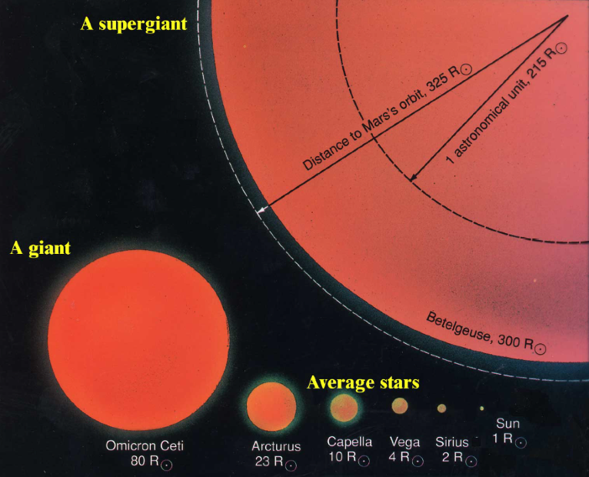
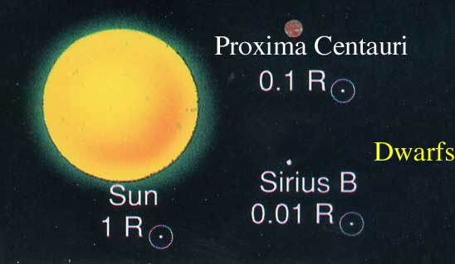
The size of stars
How big are the stars?
Can’s see size in telescope - all stars are just dots.
Once we know
• the absolute magnitude (M) solve M = - 2.5 lg L/L_{Vega} for L
• the temperature (T) solve L/A = σ T⁴ for A
• calculate the size (radius r) solve A=4r²π for r
The result:
a wide variety of sizes:

Slide 18
Questions coming …

Slide 19
Question 10
sec
30
29
28
27
26
25
24
23
22
21
20
18
17
16
15
14
13
12
11
10
9
8
7
6
5
4
3
2
1
0
19
How do we know the sizes of stars?
A Observing how large the star looks in the telescope, and using the distance to the star from parallax.
B We don’t know it at all.
C Calculating it from knowledge of absolute brightness and temperature.
D We know the size of stars only from spaceships that went there and returned.

Slide 20
What is burning?
What fuels the stars?
Stars give off a lot of heat: need to keep up for a long time - need very effective fuel
Only nuclear (fusion) provides enough energy.
Burning is not enough.
… is a chemical reaction: fusion with oxygen
Coal:
Hydrogen (gas):
More precisely:
Octane (car fuel):
Oxygen
coming form the air
Notice: number of atoms is conserved.
(No change of nuclei in chemistry!)

Slide 21
Questions coming …

Slide 22
Question 11
sec
30
29
28
27
26
25
24
23
22
21
20
18
17
16
15
14
13
12
11
10
9
8
7
6
5
4
3
2
1
0
19
What chemical do you need (other than the coal)
for burning coal and what is the result?
A Need: oxygen; Result: carbon dioxide.
B Need: carbon; Result: oxygen.
C Need: hydrogen; Result: water.
D Need: nitrogen; Result: nitrogen acid.
E Need: oxygen; Result: only ash.
Next question coming …

Slide 23
Question 12
sec
30
29
28
27
26
25
24
23
22
21
20
18
17
16
15
14
13
12
11
10
9
8
7
6
5
4
3
2
1
0
19
What is burning?
A The production of heat.
B Conversion of electrical energy into heat and light.
C A chemical fusion with oxygen.
D A nuclear reaction that turns hydrogen, carbon, or other chemical elements into more complicated ones and releases heat.
E The production of energy.

