Slide 1
Photons
Einstein’s • light comes in chunks (photons)
discovery: • each photon has E=1240/λ energy
in electron-volts (eV) in nm’s
Examples:
Red λ = 720 nm, E = 1.7 eV
Blue λ = 420 nm, E = 3 eV
UV λ = 100 nm, E = 12 eV
X-ray λ = 1 nm, E = 1200 eV
Enough to destroy most atoms
Destroys everything if strong
Do remember this:
shorter wavelength – more energetic photons

Slide 2
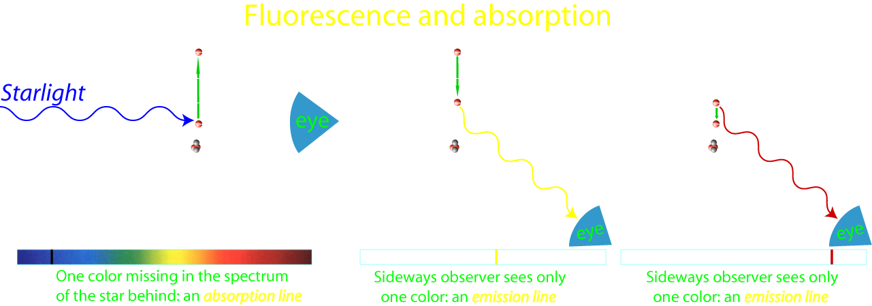
The formations of spectral lines
Example: a star’s spectrum
Example: nebula’s spectrum

Slide 3
Question 18
sec
30
29
28
27
26
25
24
23
22
21
20
18
17
16
15
14
13
12
11
10
9
8
7
6
5
4
3
2
1
0
19
Which of the following is correct about
red and blue light?
A Red light always contains more photons than blue light.
B Red light always contains fewer photons than blue light.
C A blue photon is more energetic than a red photon.
D A blue photon is less energetic than a red photon.
Next question coming …

Slide 4
Question 19
sec
30
29
28
27
26
25
24
23
22
21
20
18
17
16
15
14
13
12
11
10
9
8
7
6
5
4
3
2
1
0
19
In a planetary nebula, what type of spectrum would
the central star and the nebula have?
A Star: continuous spectrum; Nebula: emission spectrum.
B Star: absorption spectrum; Nebula: emission spectrum.
C Star: emission spectrum; Nebula: absorption spectrum.
D Star: absorption spectrum; Nebula: continuous spectrum.
E Star: continuous spectrum; Nebula: absorption spectrum.

Slide 5
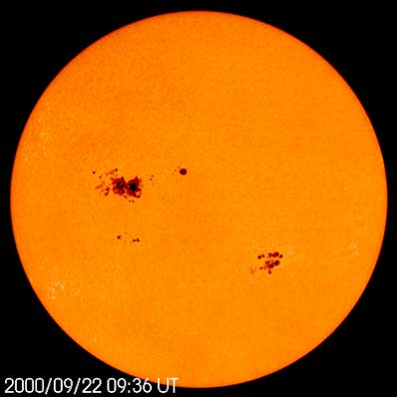

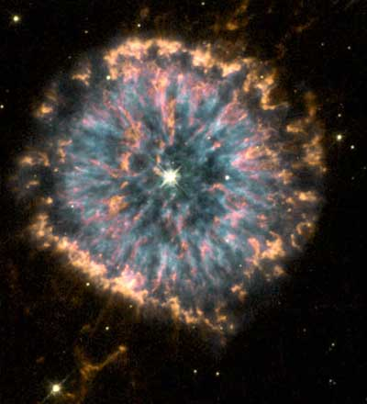

Light production
In astronomy
Light is produced by:
The Sun
• Stars are hot, glowing: thermal radiation
continuous/absorption spectrum
(or absorption spectrum when colder gas is in front)
• Hot stars’ UV cause interstellar gas glow: fluorescence
emission spectrum
NGC 6369
[Also: white shirts glow in “black light”]

Slide 6
Questions coming …

Slide 7
Question 20
sec
30
29
28
27
26
25
24
23
22
21
20
18
17
16
15
14
13
12
11
10
9
8
7
6
5
4
3
2
1
0
19
What type of spectrum is generated in fluorescence?
A Continuous.
B Absorption.
C Emission.
D None.
E A mix of emission and continuous spectra.
Next question coming …

Slide 8
Question 21
sec
30
29
28
27
26
25
24
23
22
21
20
18
17
16
15
14
13
12
11
10
9
8
7
6
5
4
3
2
1
0
19
What is thermal radiation?
When substances (gas in astronomy) …
A glow because they reflect the light of a star.
B glow because they are hot.
C glow because they are illuminated by UV light.
D glow because they reflect sunlight.
E glow because electrically charged particles hit magnetic fields.

Slide 9
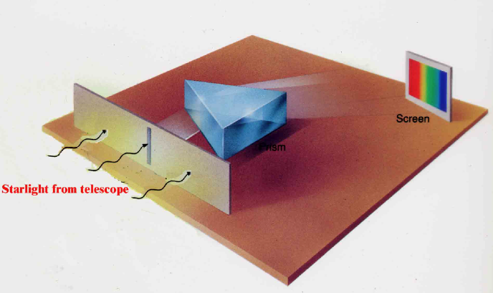
The spectroscope
The device that resolves the colors of light:
the spectroscope
(Joseph von Fraunhofer, 1814)
• Light from telescope enters
slit (to block off stray light)
• Prism (or grating) separates
the colors
• Produces spectrum
on a screen/on a film
(Put this device in a box and
attach it to the telescope)
Spectrum: each color is a “line”
Surprise:
The spectrum of the Sun
has black lines:
Some colors are missing!
(Fraunhofer-lines)

Slide 10

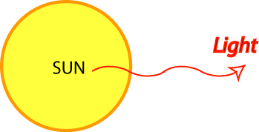
The spectrum of the Sun
Hα
(Color and b/w version of the same thing.)
Hβ
Hγ
Absorption lines (“Frauenhofer-lines”),
many in hydrogen wavelengths
Here: colder gas takes out a few colors
Solar atmosphere

Slide 11
Questions coming …

Slide 12
Question 22
sec
30
29
28
27
26
25
24
23
22
21
20
18
17
16
15
14
13
12
11
10
9
8
7
6
5
4
3
2
1
0
19
The spectrum of the Sun consists of
A a few bright lines only.
B dark lines over a bright continuum.
C dark bands of light with bright centers, over a bright continuum.
D a continuous bright spectrum like a rainbow.
E a few bright bands with dark centers.
Next question coming …

Slide 13
Question 23
sec
30
29
28
27
26
25
24
23
22
21
20
18
17
16
15
14
13
12
11
10
9
8
7
6
5
4
3
2
1
0
19
What are Fraunhofer lines?
A linear clouds in the disc of Jupiter.
B emission lines in the spectrum of a diffuse nebula.
C absorption lines in the spectrum of the Sun.
D dark lines connecting red spots on Mars.
E fake spectral lines in a spectroscope due to diffraction of light.

Slide 14


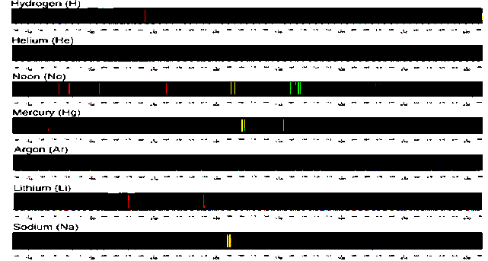
Recall the types of spectra
Continuous spectrum
(thermal glow)
Absorption spectrum
(cold gas illuminated from behind)
Emission spectrum
(by rarified gas: fluorescence)
Each chemical element
has its own spectral lines:
A good way to tell
the chemical composition
of a star!

Slide 15
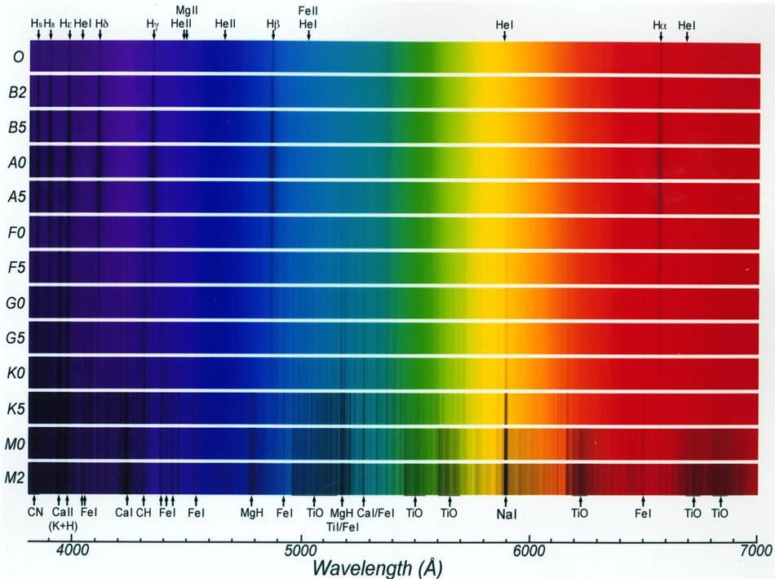
The spectra of stars – the effect of photospheric temperature
Example: hydrogen lines are strongest in A0 stars (at 10000K) – explain why?
20,000K
9,000K
6,000K
3,000K

Slide 16
THE REST OF THIS SLIDESHOW HAS
NOT BEEN DISCUSSED IN CLASS.
IT IS SUGGESTED BUT NOT REQUIRED MATERIAL.

Slide 17
Questions coming …

Slide 18
Question
sec
30
29
28
27
26
25
24
23
22
21
20
18
17
16
15
14
13
12
11
10
9
8
7
6
5
4
3
2
1
0
19
How do we tell precisely the spectral type of stars?
Based on …
A a calculation of the star’s brightness.
B the overall color of the star.
C which spectral lines are strongest.
D the width (or profile) of spectral lines.
E the Doppler-shift in individual spectral lines.
Next question coming …

Slide 19
Question
sec
30
29
28
27
26
25
24
23
22
21
20
18
17
16
15
14
13
12
11
10
9
8
7
6
5
4
3
2
1
0
19
Metal lines are strongest in a star’s spectrum
when the star is … ?
A Hottest.
B Coldest.
C Largest.
D Smallest.
E Closest.

Slide 20
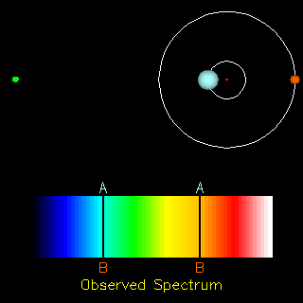
Stars - single and double
• Half of the stars are doubles
• Singles, doubles, triples, small clusters, large clusters
• All stars are born in clusters
but get “expelled” pretty soon after birth (~200 million years)
Situations and their names:
• Binaries – noticeably orbiting
(often hard to resolve them : spectroscopic binaries)
• Common proper motion doubles (too far separated to orbit)
• Chance doubles

Slide 21
Questions coming …

Slide 22
Question
sec
30
29
28
27
26
25
24
23
22
21
20
18
17
16
15
14
13
12
11
10
9
8
7
6
5
4
3
2
1
0
19
How fast do visual binaries normally revolve
(those double stars that can be seen in the telescope
to orbit each other)?
A Once in a few minutes.
B Once in a few years.
C Once in decades or centuries.
D Once in millions of years.
Next question coming …

Slide 23
Question
sec
30
29
28
27
26
25
24
23
22
21
20
18
17
16
15
14
13
12
11
10
9
8
7
6
5
4
3
2
1
0
19
How many double star systems are there?
A Very few: out of the billions of stars in the Galaxy,
only a hundred are doubles.
B Only a few: 99% of stars, like the Sun, are singles.
C About the half of the stars are doubles.
D Almost all stars are doubles.

Slide 24
Example: spectroscopic binaries
Measure:
* Blue/red shift of lines
* Time period
Earth
Calculate:
* Orbital speed
( shift in % of wavelength
= speed in % of speed of light )
* Size of orbit
( time period × speed = 2 r π )
* Mass of stars
( Kepler III: M × T² = r³ )

Slide 25
The mass of stars
:
use binaries
Measure:
a
Period (T) in years
Size of orbit (a) in AU’s
Kepler’s III law tells mass:
M T² = a³
solve this for M
Example:
A binary system has been measured to turn around in 55 years
Stars separated 3 arc second
Parallax is 0.067 arc second.
Use these data to figure out the system:
Distance to stars from parallax: 15 parsecs
a = 45 AU and T = 55 years, plug in and solve equation
mass = 30 solar masses (very big stars)

Slide 26
Questions coming …

Slide 27
Question
sec
30
29
28
27
26
25
24
23
22
21
20
18
17
16
15
14
13
12
11
10
9
8
7
6
5
4
3
2
1
0
19
Why are double stars important in astronomy?
A They help us to measure the distance to stars.
B They provide the only way to measure the mass of the stars.
C They help us find out what substances stars are made of.
D They help us find out how fast stars revolve around the center of the Galaxy.
Next question coming …

Slide 28
Question
sec
30
29
28
27
26
25
24
23
22
21
20
18
17
16
15
14
13
12
11
10
9
8
7
6
5
4
3
2
1
0
19
How do we know the mass of (some) stars?
A Using measurements of their planets.
B Using measurements of the force of their gravity on spaceships.
C Using the red/blue shift of spectral lines of binary stars.
D Using measurements of their brightness and color.

Slide 29
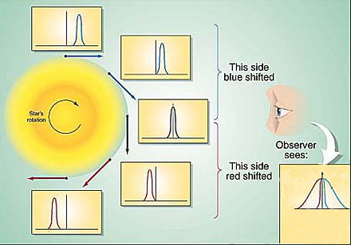
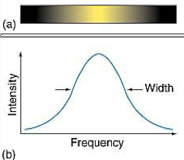
What do spectra tell us?
The details of the spectra tell a lot:
• Chemical composition: which lines are present
• Rotation: broadening (same percent for all lines)
• Movement (towards us or away from us): shift lines (same percent for all lines)
• Strength of magnetic field (if any): split of lines into doublets
• Temperature: relative line strengths of the same atom
For example, H_{α} (level 2 to 3, red) vs. P_{α} (Paschen-α, level 3 to 4, infrared) transition in H atom.
• Gas density (gravity), chaotic wind speed: broadening (varies from atom to atom)
• Mass loss (stellar wind): P Cygni profile (blue-shifted emission + unshifted absorption)
Example: Rotational
line broadening:
(all spectral lines broadened
by the same percent)

Slide 30
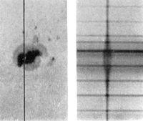
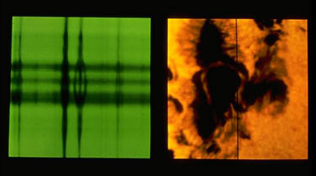
Example: the Zeeman effect
(splitting lines into doublets/triplets by the magnetic field)
shorter longer
wavelength
Zeeman split is strong inside sunspot
(split is proportional magnetic field strength)
on this picture, maximum magnetic field strength is
~ 1 Tesla (10 times stronger than a household magnet)
extends to an area size of the US
Spectrograph’s slit
Excludes light outside this line

Slide 31
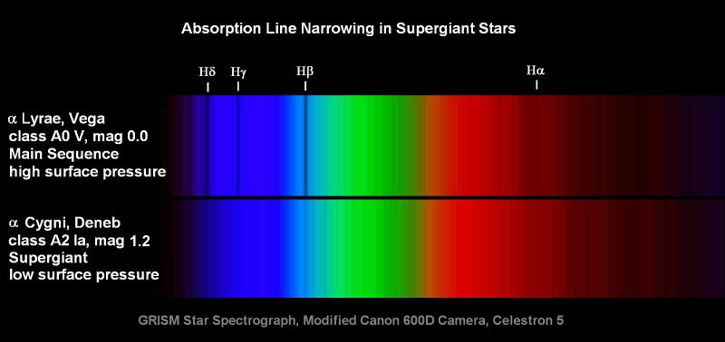
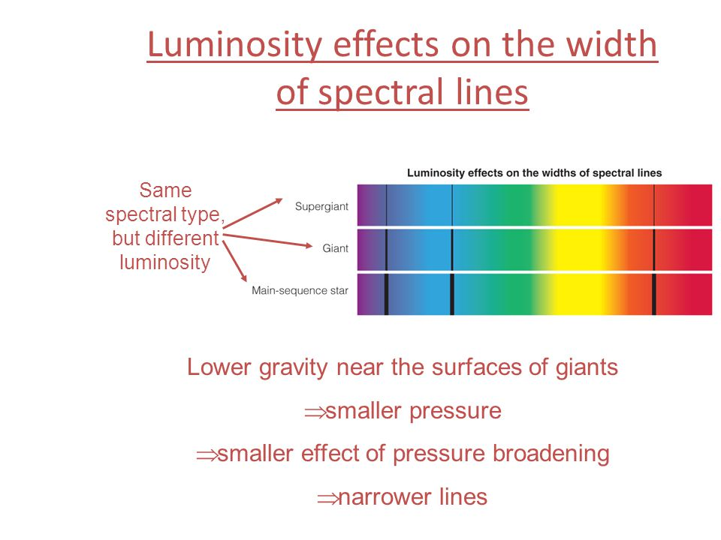
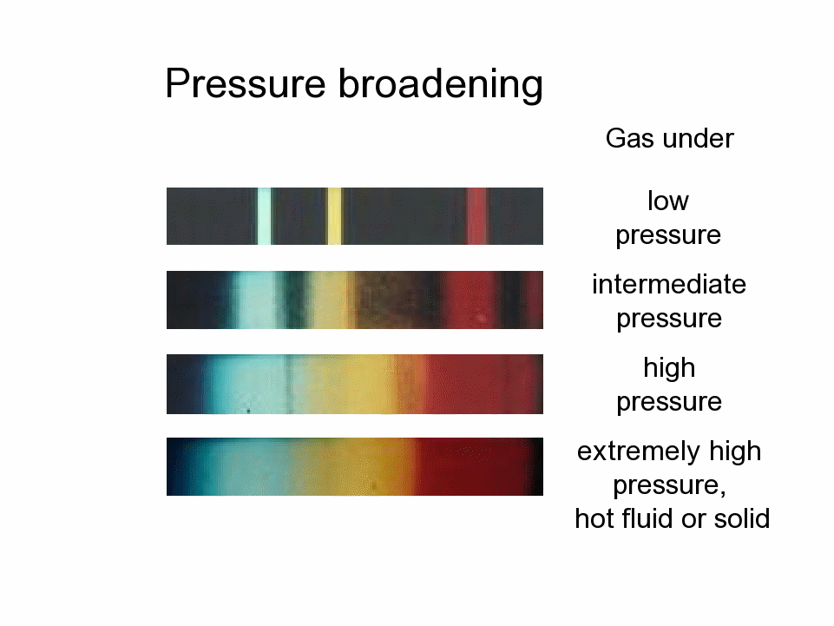
Example: pressure broadening
(giant stars have narrow lines)
The spectrum tells us the surface gravity (i.e. luminosity class)

Slide 32
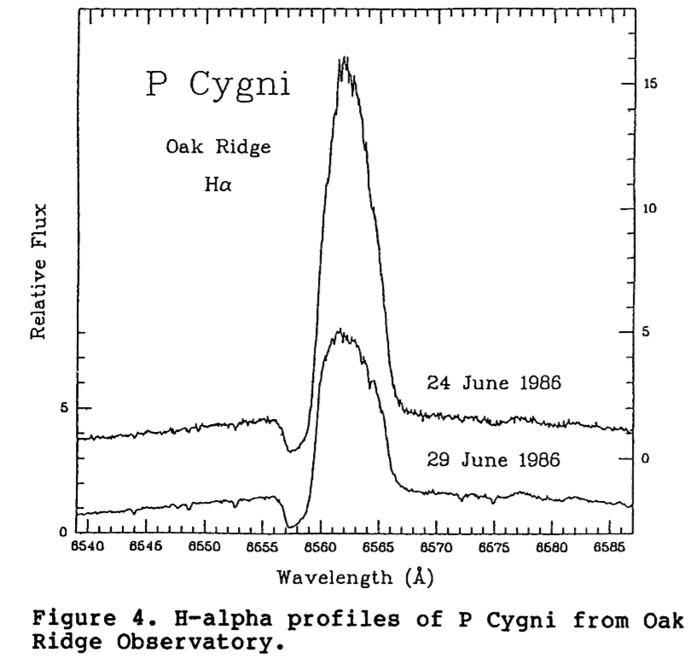
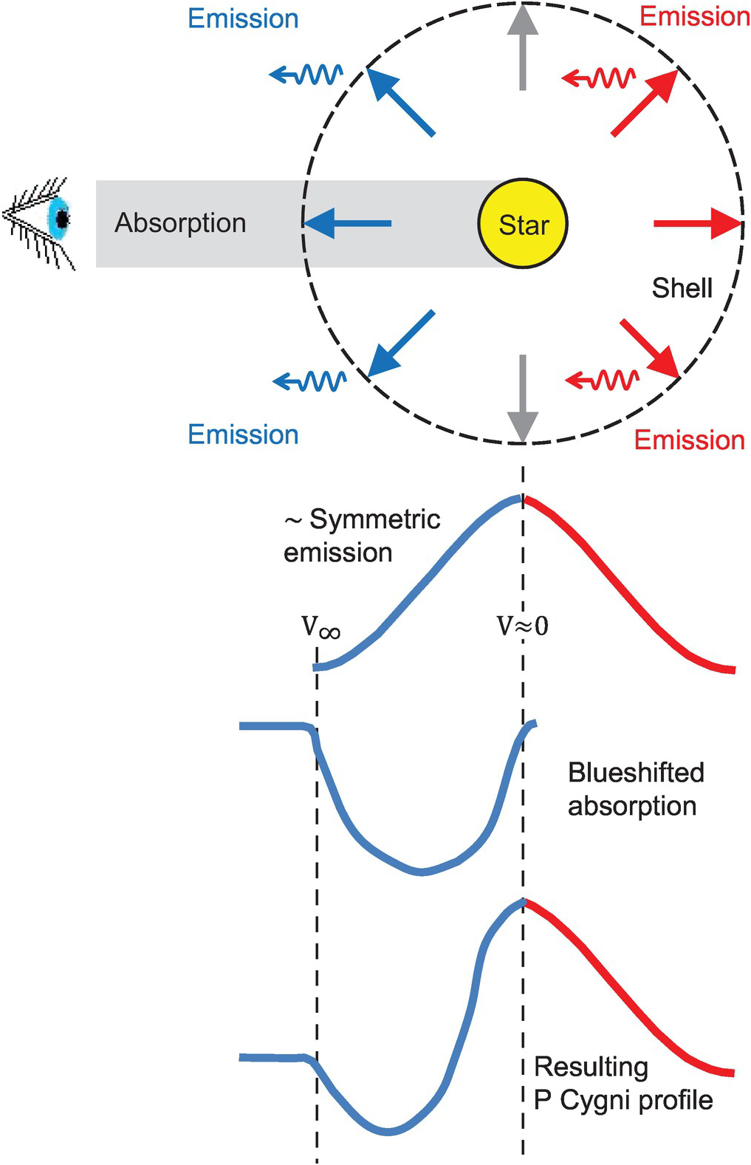
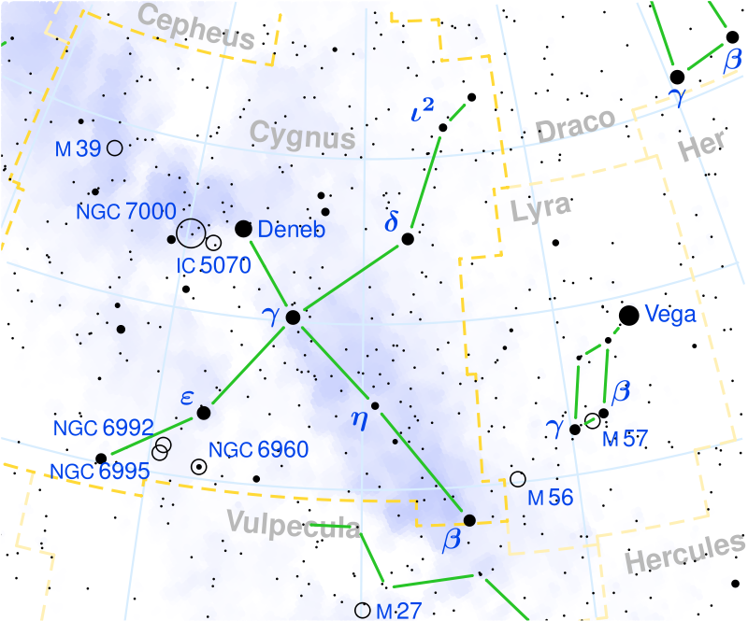
Example:
P Cygni profile
Stellar wind’s effect
on the profile
of a spectral line:
Blue absorption, red emission
Seen only when
a star’s stellar wind is strong
(i.e. a lot of mass loss)
“P Cygni” is a variable star designation.

Slide 33
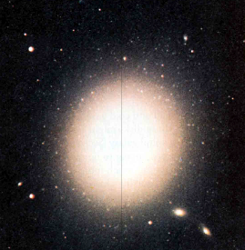
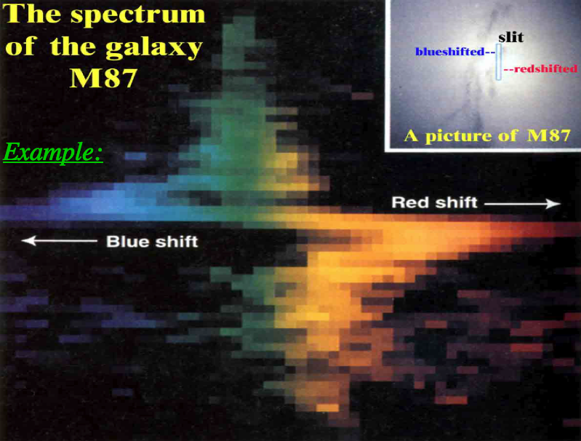
Example: a rotating galaxy
The top of the slit shows blueshift -
- stars there are moving towards us
The bottom of the slit shows redshift -
- stars there are moving away:
Example:
Top of slit moves
our way
Bottom of slit moves
away from us
Rotation is fastest
in the middle
(Colors are fake – this is a small part of the spectrum only!)

