Slide 1


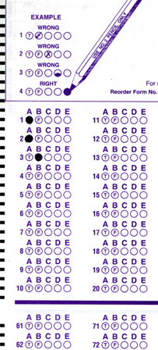
Setup:
Prepare your scantron:
Use
a pencil,
not a pen!
Fill in your name and fill the bubbles under
your name.
LAST NAME FIRST, First name second
Put your 4-digit code instead of “IDENTIFICATION NUMBER”.
--- (The last 4 digits of your OleMiss ID.)
Recall reading assignment
Chapter 5, Light and matter, pp. 137 – 164
Question # 1: answer A
Question # 2: answer B
Question # 3: answer D
• Monday class missed – apologies
• Midterm grades posted only on our website
• Review quiz (deep sky objects) postponed to Monday March 23
• Test 2: canceled
Please take a moment to mute your cell phone!

Slide 2
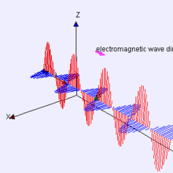
The physics of light
Light … is an electromagnetic wave:
• … is a wave pattern
of electric and magnetic fields
• … propagates in vacuum
• … has wavelength (blue: 400 nm, red: 700 nm)
Learn
units of distance!
1 mm = millimeter
1000 μm = 1 mm
1000 nm = 1 μm
Millimeter
(size of ant)
0.4 μm
0.7 μm
Micrometer
(size of a germ)
Nanometer
(size of ten atoms)

Slide 3

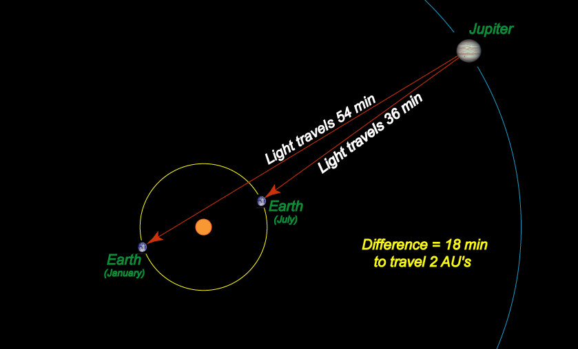
Olaf Römer
Speed of light c = 300,000 km/s:
Discovered by: Olaus Roemer (1675)
Memorize this, please.
This clip is only visible in a PowerPoint Slide Show.
Otherwise, go to: www.phy.olemiss.edu/~ttorma/Astro/Presentations/ASTR104/AlwaysUp/JupDance.gif
Light takes
• a few minutes/hours
to move around in
the solar system
• years or more
to go from
star to star
• Eclipses of Jupiter’s moons come a few minutes late
when Jupiter is on the far side of its orbit.
• Reason: light needs extra time to reach us.
• Conclusion: light needs ~9 minutes (=500 sec) to come Sun to Earth.
• 1 au / 500 sec = 150 million km / 500 sec = 300,000 km/sec

Slide 4
Questions coming …

Slide 5
Question 4
sec
30
29
28
27
26
25
24
23
22
21
20
18
17
16
15
14
13
12
11
10
9
8
7
6
5
4
3
2
1
0
19
Which one is fastest?
A Radio waves
B X-rays
C Visible light
D Laser
E The same
Next question coming …

Slide 6
Question 5
sec
30
29
28
27
26
25
24
23
22
21
20
18
17
16
15
14
13
12
11
10
9
8
7
6
5
4
3
2
1
0
19
How was the speed of light measured for the first time?
A In an experiment with a laser beam.
B By the time delay the astronauts’ answer came from the Moon.
C Observing the moons of Jupiter.
D By measuring the radar signal reflected by the Moon.
E By measuring the time light takes to arrive to us
from another galaxy.

Slide 7
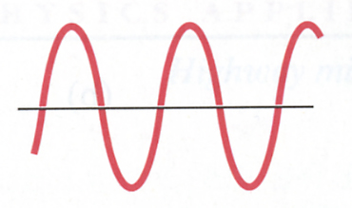
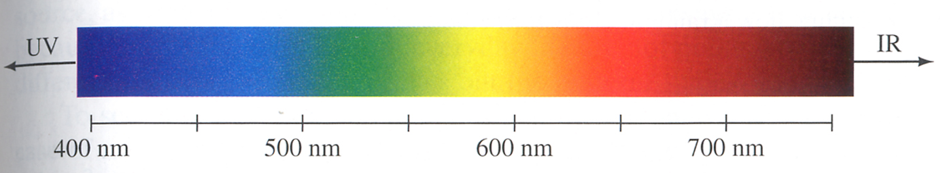
The electromagnetic spectrum
Light has a wavelength:
λ
Wavelength of light means color:
IR
UV
700 nm
600 nm
500 nm
400 nm
• Blue has short wavelength
• Red has long wavelength
These are colors of light
invisible to the eye.
What is
beyond blue?
Bluer than blue is UV (ultraviolet) - even shorter wavelength
Redder than red is IR (infrared) - even longer wavelength

Slide 8
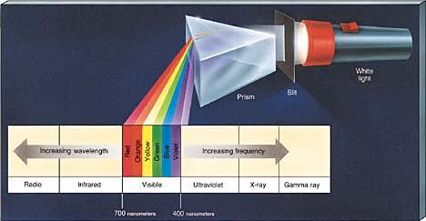
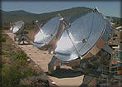
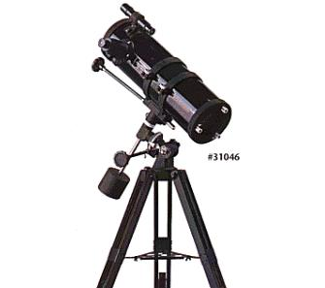
The full spectrum
And what is beyond those wavelengths?
(A prism breaks up white light into colors.)
White light
Slit
Prism
Radio | Infrared | Visible | Ultraviolet X-ray| γ -ray
Radio antenna
Eye / Telescope
Need spacecraft
(Far UV, X-ray, γ-ray)
Need spacecraft
They all move with the same speed c = 300,000 km/s

Slide 9
Questions coming …

Slide 10
Question 6
sec
30
29
28
27
26
25
24
23
22
21
20
18
17
16
15
14
13
12
11
10
9
8
7
6
5
4
3
2
1
0
19
What is the difference between red and blue light?
A Intensity.
B Speed.
C Wavelength.
D Blue is composite, red is not.
E Red is existence of light, blue is lack of light.
Next question coming …

Slide 11
Question 7
sec
30
29
28
27
26
25
24
23
22
21
20
18
17
16
15
14
13
12
11
10
9
8
7
6
5
4
3
2
1
0
19
Astronomical origin X-rays can be observed only …
A using very large telescopes
B on high mountains
C from space
D with cameras attached to telescopes on high mountains
E on Antarctica

Slide 12
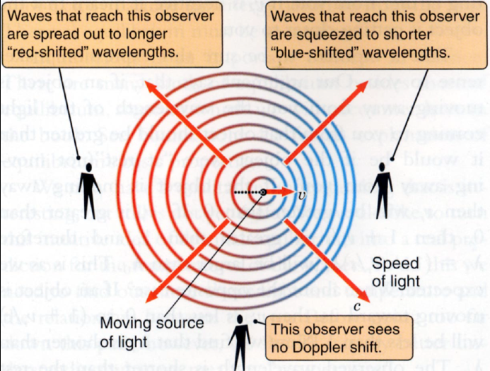
The Doppler effect
The effect of motion on spectral lines:
• Light source moves towards observer: spectral lines are shifted towards blue
• Light source moves away from observer: spectral lines are shifted towards red
• Light source moves sideways: no change
How large is the
Doppler effect?
Usually tiny.
% shift in λ =
speed in % of
the speed of light
Realistic example:
30 km/s 0.01% shift
(this is the orbital speed of Earth)

Slide 13
Questions coming …

Slide 14
Question 8
sec
45
40
35
30
25
19
18
17
16
15
14
13
12
11
10
9
8
7
6
4
3
2
1
0
20
5
What is the Doppler effect?
A Stars move on tiny circles in the sky, once a year.
B The stars appear red when they are rising or setting.
C Far-away stars appear red because the Universe is expanding.
D The spectral lines of a star are shifted towards red, if the star is moving away from us, and towards blue, if the star is approaching us.
E A fast moving star’s spectral lines are shifted towards red, independently of the direction of motion.
Next question coming …

Slide 15
Question 9
sec
30
29
28
27
26
25
24
23
22
21
20
18
17
16
15
14
13
12
11
10
9
8
7
6
5
4
3
2
1
0
19
Which of the following happens to the sound of the whistle coming from a train approaching us at high speed?
A It becomes lower-pitched.
B It becomes higher-pitched.
C It becomes less loud.
D It becomes more loud.

Slide 16



The spectrum of another star
Hα
The Sun
Hβ
Hγ
Polaris
Spectral lines shifted towards blue:
Polaris is approaching us
Measure shift: find radial speed
17 km/s
Why are the spectral lines shifted? -- the Doppler effect

Slide 17
Question coming …

Slide 18
Question 10
sec
30
29
28
27
26
25
24
23
22
21
20
18
17
16
15
14
13
12
11
10
9
8
7
6
5
4
3
2
1
0
19
In what are spectra of other stars different from
the Sun’s?
A The same spectral lines are there in every star’s
spectra, but they may be shifted if the star is moving.
B Different spectral lines may be visible, in addition
to Doppler-shift.
C All stars have the same spectrum because they are all made of gas.
D The spectrum is the same, except that the blue part of hotter stars’ spectra is brighter.

