Slide 1
Equations of Motion in an Expanding Universe
Sergei Kopeikin

Slide 2
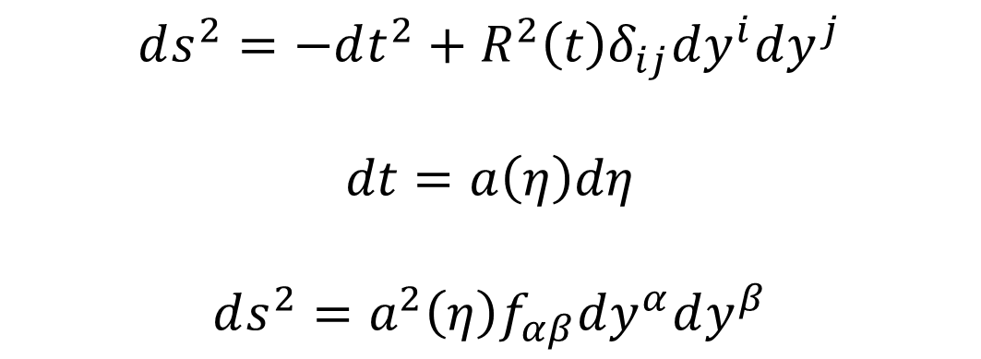
Expanding Universe = Conformally-flat Manifold
$$ds^{2}=−dt^{2}+R^{2}\left(t\right)δ_{ij}dy^{i}dy^{j}$$
$$dt=a\left(η\right)dη$$
$$ds^{2}=a^{2}\left(η\right)f_{αβ}dy^{α}dy^{β}$$
$$y^{α}=\left(η,y^{i}\right)−conformal coordinates ; a\left(η\right)≡R[t\left(η\right)]$$
t - proper time of Hubble observers (physical time)
$$η −conformal time (mathematically convenient, unphysical)$$

Slide 3
We are interested in studying the laws of local physics on the conformally-flat manifold. Focus on the (Einstein) equivalence principle. It states that there exists a diffeomorphism $y=y\left(x\right)$ from global, $y^{α}$, to local inertial coordinates, $x^{α}=(τ,x^{i})$, such that $$ds^{2}=f_{αβ}dx^{α}dx^{β} and Γ_{βγ}^{α}=0$$ and local equations of motion for test particles: $$\frac{d^{2}x^{α}}{dτ^{2}}=0$$

Slide 4
We simplify theory by sticking to the linearized Hubble approximation in all equations. Local diffeomorphism: ${{ a}^{2}(η)f}_{μν}\frac{∂y^{μ}}{∂x^{α}}\frac{∂y^{ν}}{∂x^{β}}=f_{αβ}$ Special conformal transformation: ${Ω^{2}(x)f}_{μν}\frac{∂y^{μ}}{∂x^{α}}\frac{∂y^{ν}}{∂x^{β}}=f_{αβ}$ $$Ω\left(x\right)=1−2b_{α}x^{α}+b^{2}x^{2}$$ $$y^{α}=\frac{x^{α}−b^{α}x^{2}}{Ω\left(x\right)}$$ Matching: $b^{α}=\frac{H}{2}u^{α}$ ; $Ω\left(x\right)=a\left(τ\right)=1+Hτ$

Slide 5
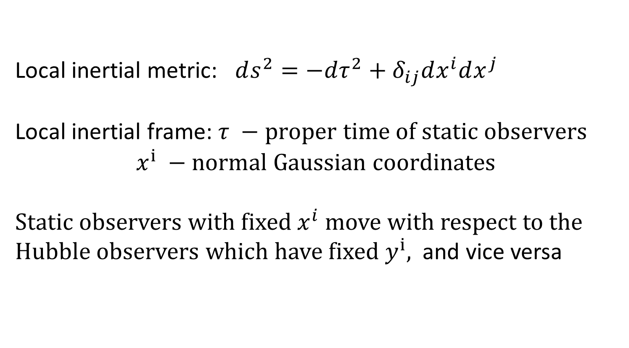
Local inertial metric: $ds^{2}=−dτ^{2}+δ_{ij}dx^{i}dx^{j}$ Local inertial frame: $τ −proper time of static observers$ $$x^{i} −normal Gaussian coordinates$$ Static observers with fixed $x^{i}$move with respect to the Hubble observers which have fixed $y^{i},$ and vice versa
$x^{i}=a\left(τ\right)y^{i}$ $\frac{dx^{i}}{dτ}=Hy^{i}$ Hubble law
$$τ=t+O\left(H^{2}\right) proper time τ of static observers$$
$coincides with the cosmic time$ t

Slide 6
Focus on motion of photons (light). Equations of motion of light in global coordinates: $\frac{d^{2}y^{α}}{dη^{2}}=0$ We expect in local (Gaussian) coordinates: $\frac{d^{2}x^{α}}{dτ^{2}}=0$ Coordinate transformation: $τ=a\left(η\right)η x^{i}=a\left(η\right)y^{i}$ However, operationally $τ=t$. Hence, we conclude $$t=a\left(η\right)η=η+Hη^{2}+O(H^{2})$$ But the cosmic and conformal times are related by $$t=∫a\left(η\right)dη=η+\frac{H}{2}η^{2}+O(H^{2})$$ Contradiction! Something is wrong with our postulates.

Slide 7
We cannot postulate that the affine parameter on light geodesic is the proper time of static observers. It must differ from $τ$ Conformal transformation: $λ=a\left(η\right)η x^{i}=a\left(η\right)y^{i}$ $$λ=a\left(η\right)η=η+Hη^{2}+O(H^{2}) \\ t=∫a\left(η\right)dη=η+\frac{H}{2}η^{2}+O(H^{2})$$ No contradiction! But the price to pay is that the local inertial metric differs from the optical metric on light cone (Synge, Perlick) $ds^{2}=−dλ^{2}+δ_{ij}dx^{i}dx^{j}$ $ds^{2}=−a^{2}(τ)dτ^{2}+δ_{ij}dx^{i}dx^{j}$ $\frac{d^{2}x^{α}}{dτ^{2}}=H\left(\frac{dx^{α}}{dτ}−u^{α} \right)$ local equations of motion for photons
$$dλ=a\left(τ\right)dτ$$

Slide 8
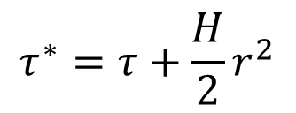
Radar and laser ranging: solving $ds=0$ Radial geodesics, observer at the origin of the local coordinates $dr=±a\left(±τ\right)dτ$ $+$ outgoing ray, $−$ incoming ray $$r=r_{0}±τ+\frac{H}{2}τ^{2}$$ $$r=r_{0}±\left(τ−τ_{0}\right)+\frac{H}{2}{(τ−τ_{0})}^{2}$$ $$r_{1}=r_{0}±\left(τ_{1}−τ\right)+\frac{H}{2}{(τ_{1}−τ)}^{2}$$ $ℓ=\frac{1}{2}\left(τ_{1}−τ_{0}\right)$ For central observer$: ℓ=r$ ;
$$τ_{1}$$
$$τ^{∗}$$
$$(τ ,r)$$
$$τ_{0}$$
$$τ^{∗}=τ+\frac{H}{2}r^{2}$$

Slide 9
Doppler Effect (static observers) $ω=−k_{α}u^{α}$ frequency of light $\frac{ω_{2}}{ω_{1}}=\frac{k_{0}(τ_{2})}{k_{0}\left(τ_{1}\right)}$ $\frac{dk_{α}}{dλ}=−\frac{1}{2}\frac{∂g^{μν}}{∂x^{α}}k_{μ}k_{ν}$ $$\frac{k_{0}(τ)}{a(τ)}=const.$$ $\frac{ω_{2}}{ω_{1}}=\frac{a(τ_{2})}{a(τ_{1})}$ blue shift $$\frac{ω_{2}}{ω_{1}}=1+H\left(τ_{2}−τ_{1}\right)$$
$$ω_{2}, a_{2}$$
$$ω_{1}, a_{1}$$

Slide 10
Do static observers exist in an expanding universe? The answer is affirmative. Scrutiny analysis of electromagnetic and gravitational forces reveals that they are not subject to the Hubble expansion in the linearized Hubble approximation. Atomic and planetary orbits are stable and can be used to materialize the reference frame of static observers. Hence, the local cosmological expansion (in the theoretical model proposed) can be detected, at least, in principle. Pioneer anomaly effect is naturally explained by the property of the conformal invariance of light geodesics as contrasted with time-like geodesics which are not conformally-invariant.

Slide 11
THANK YOU!

