Slide 1

Great news!
You’re using Top Hat this term!
Top Hat is a classroom response system that allows users to participate in class polls, quizzes, discussions, and more using their own devices.
With Top Hat you won’t need to purchase any new hardware, you can simply submit responses using your laptop, web-enabled smartphone with our Top Hat app (iPhone/Android), tablet, or cell-phone with text messaging.
We’re here to change your lecture experience!
Now, let’s get you set up…

Slide 2
Registering your Top Hat Account
What you’ll need to get signed up
About 5 minutes of your time.
A computer with internet access.
One of the following:
  A credit or debit card
  A subscription code purchased from the bookstore or included with your textbook (if applicable).
Your Student ID or other identifier used for grading.
Email sent to your University Email Address from the Top Hat Mailer.

Slide 3
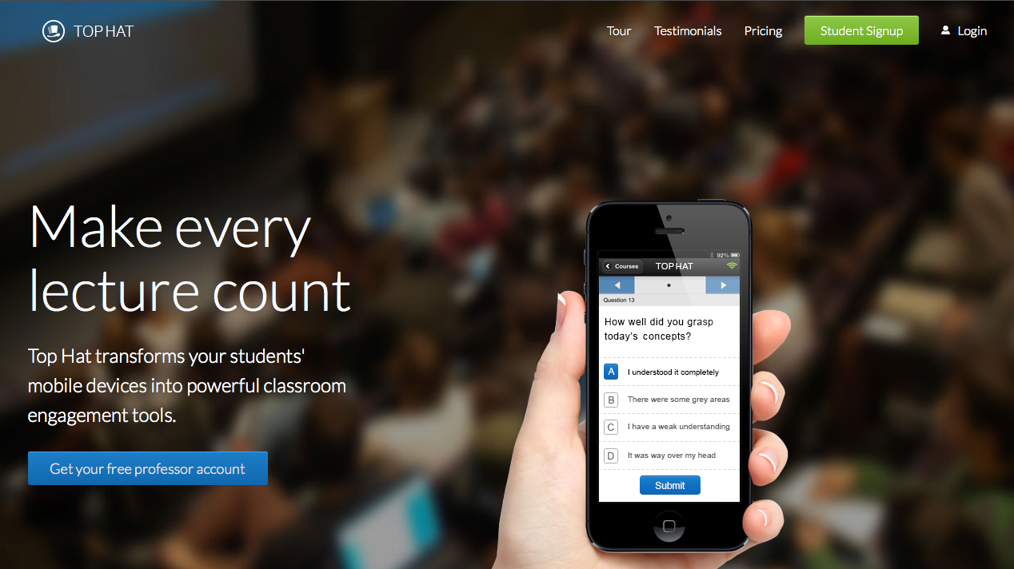
Use the email sent to your university email address from “Top Hat Mailer” to create a Top Hat account and enroll directly into this Top Hat Course.

Slide 4
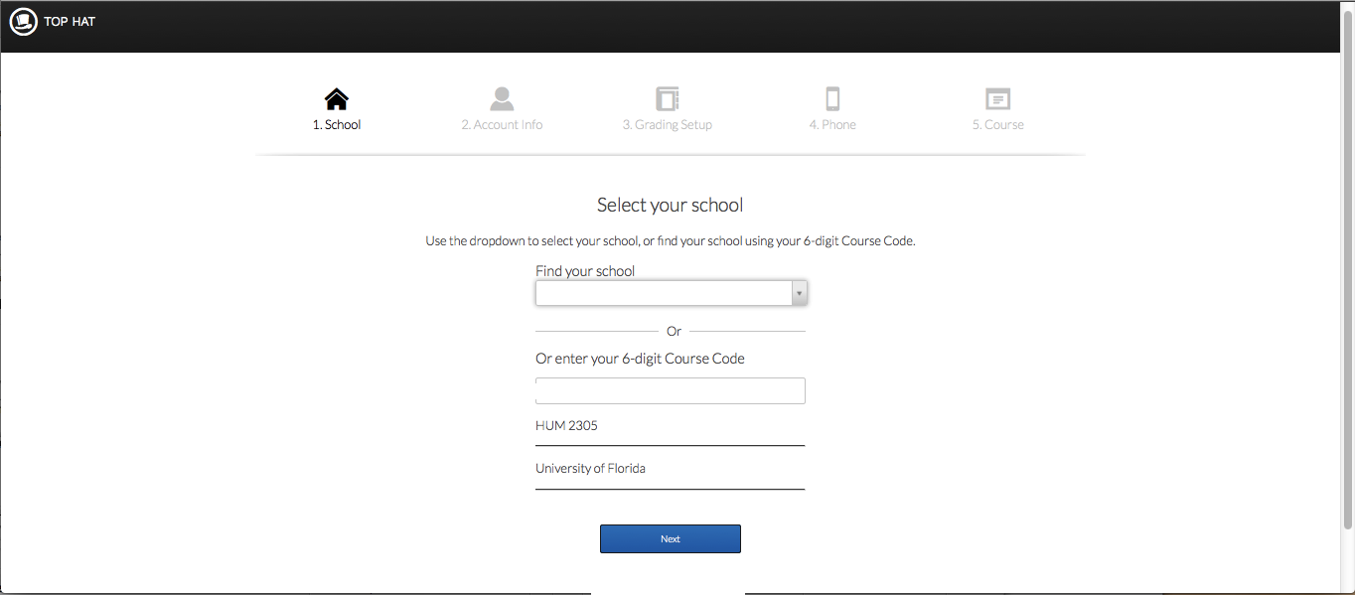
123456
By using the email sent from the Top Hat Mailer, your specific Course is pre-populated on the first step of creating your Top Hat Account.

Slide 5
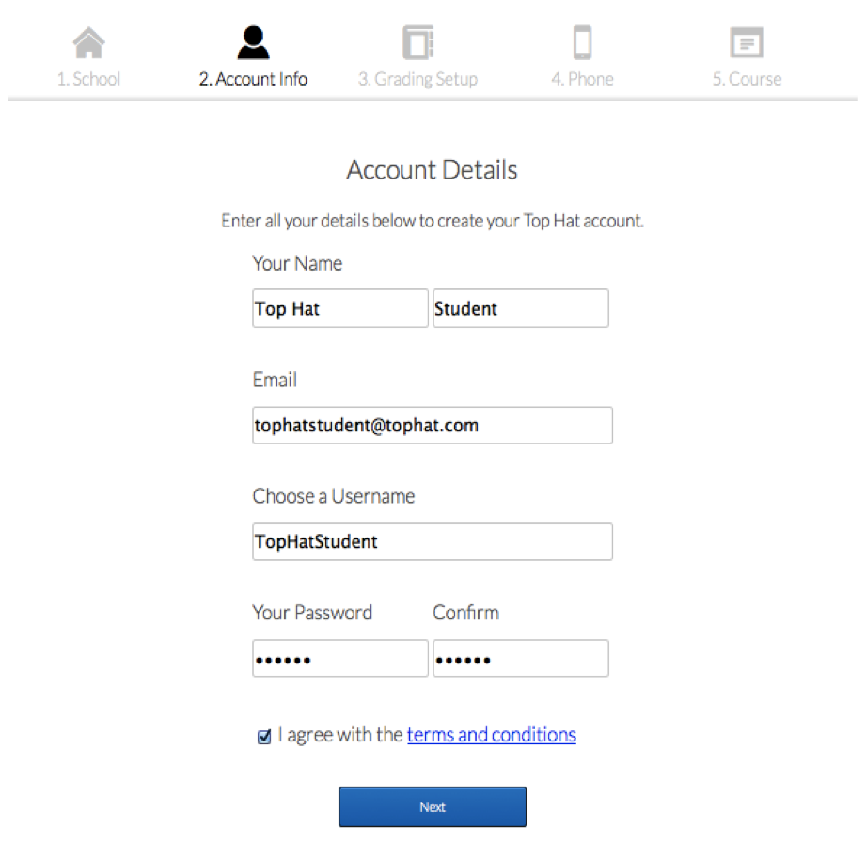
Please enter the following information:
Your Name
Your University Email address
Select a unique username
Enter a password and confirm that you’ve entered it correctly.
When you’re finished, please check the box to agree to the terms and conditions, then click the Next button.

Slide 6
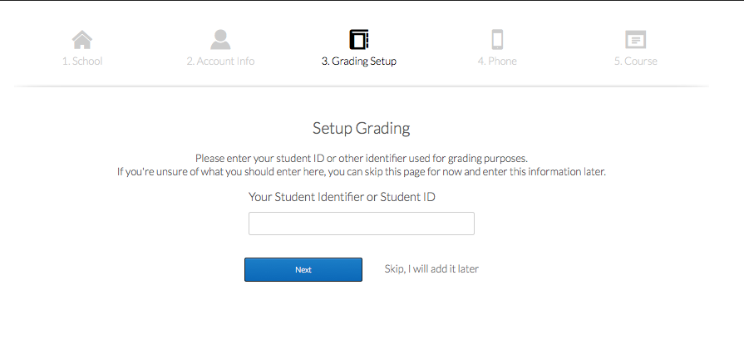
Enter your university Student ID or other identifier specified by your instructor.
If you’re unsure of what to enter here, you can skip this page and change
the information later by visiting your My Account page.
Once you’ve entered your Student ID, click the Next button to continue.

Slide 7
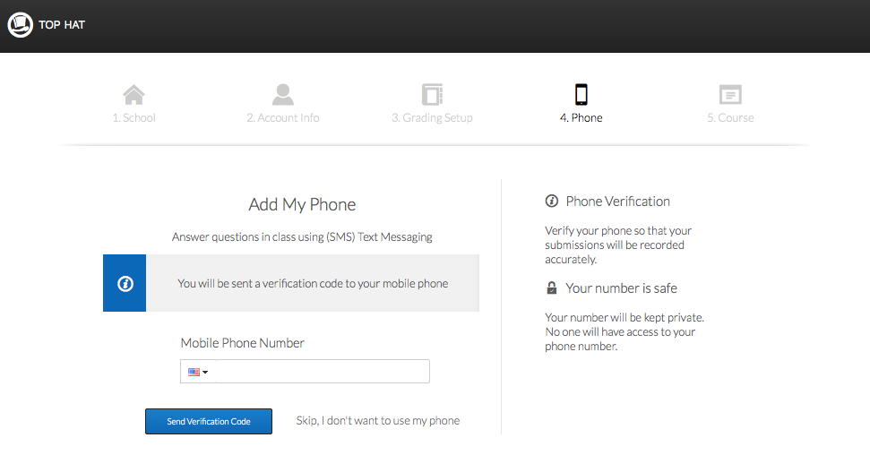
If you plan to use your cell phone to send text message responses,
please enter your phone number beginning with the area code.
You will receive a verification code shortly that to confirm that your phone
has been properly linked to your account.
Enter the code that you receive and click the Next button.

Slide 8
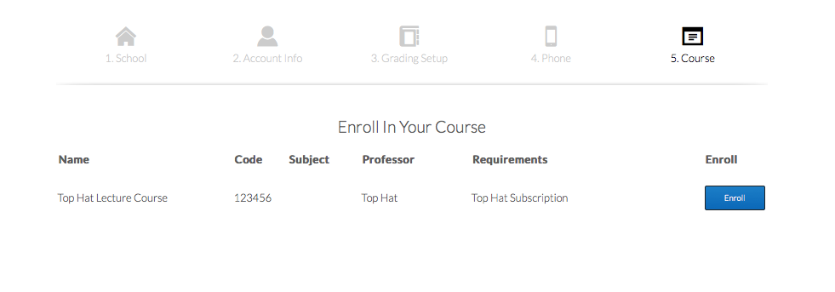
Select your first course from the list and click the Enroll button.
If you need to add more courses later, you select them in the Lobby.
If you’re unable to find the course you’re looking for, please email support@tophat.com

Slide 9
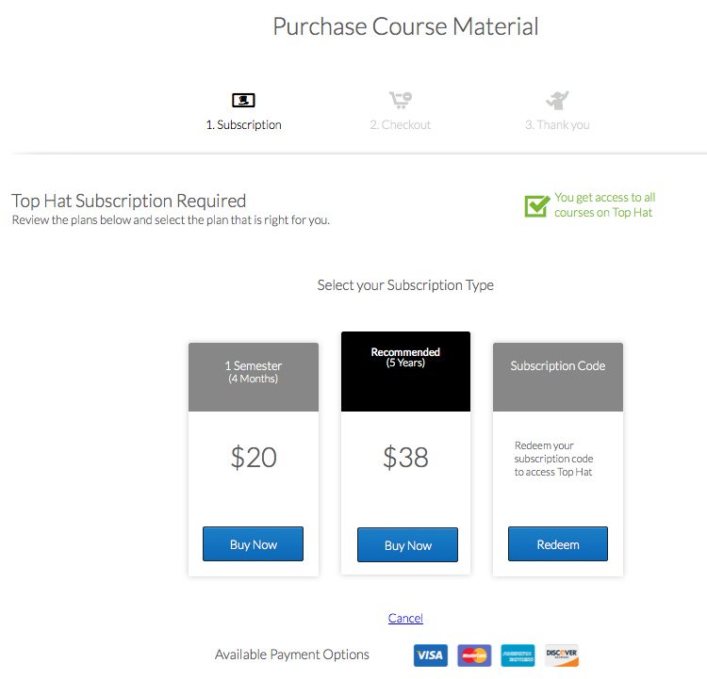
Select your Subscription Type or
redeem your Subscription Code
(if applicable)

Slide 10
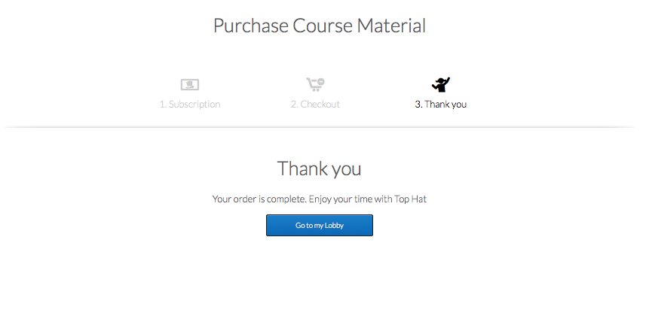
Congratulations!
When your payment has been processed, account registration is complete.

Slide 11


Need help? We can take care of that!
If you run into any trouble, don’t bug your professor about it. We’ll get you sorted out.
Here’s how to reach us:
email: support@tophat.com
http://support.tophat.com
Or click the support button:
You’re all set! Now grab your devices, class is in session!

